Slide 1



MODULE 4:
How do I make money?
Notes:
PLAY Launch League canvas video 4 (The business operations) now.

Slide 2
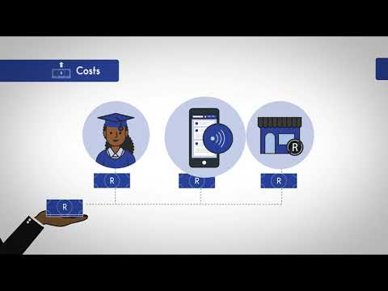
Launch League Green
Notes:
NOTE: this video uses the original Launch League business example, ABC Tutors. It is a relatable example that can still be useful to your entrepreneurs, but take extra care to explain the same concepts using the Launch League Green green economy example, Amazing Briquettes. Here is the original video link: http://www.youtube.com/watch?v=LK1JilbC4pw

Slide 3

What is Launch League?
This programme material was originally developed by the British High Commision UK-South Africa Tech Hub and Viridian through the Launch League initiative.
Launch League creates material, and training and networking opportunities for South African hubs and entrepreneur support organisations, so that we can better support YOU – promising entrepreneurs from our community!
www.launchleague.co.za
Launch League Green

Slide 4
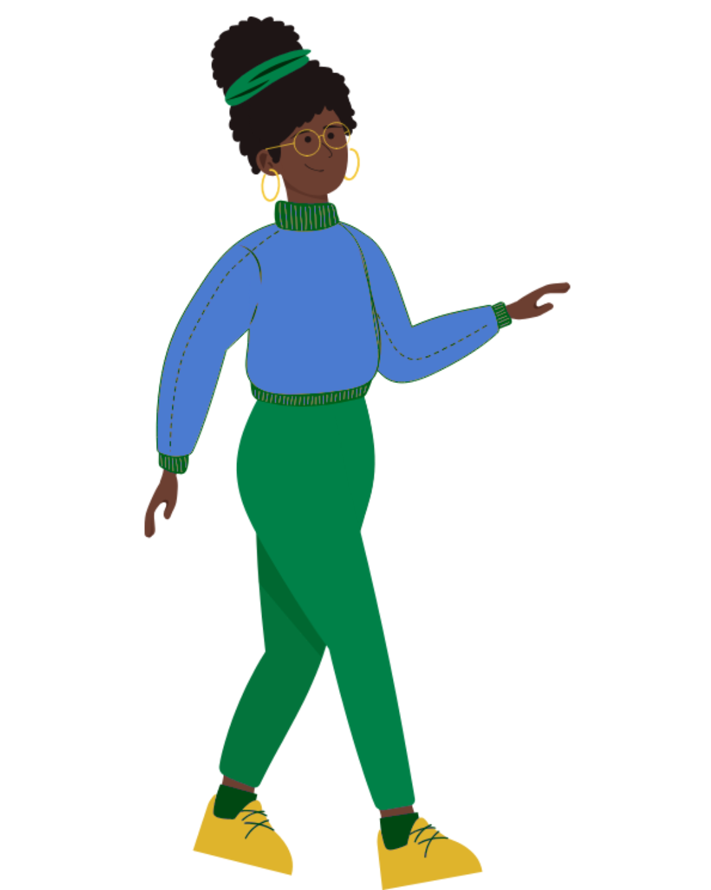
What is Launch League Green?
Businesses that have environmental sustainability at the heart of their model can not only create significant impact in our communities by solving pressing challenges, but they also have significant potential for growth and job creation due to investment interest and allocation.
Launch League Green is a programme Viridian ran in mid-2025 for entrepreneur support teams to increase their knowledge and networks to run specialised programmes for green entrepreneurs in their communities. This version of the Launch League idea-stage programme uses an example of a green business to inspire entrepreneurs in the green economy!
Launch League Green

Slide 5

1.
Business model
Launch League Green

Slide 6
A business model is how you create and deliver value to your customers and how you capture value from them.
Launch League Green
Notes:
Your business model is the big picture of a healthy business. A healthy business makes money. Specifically, it makes more money than it spends.

Slide 7
Business model
1. Create value = Product or Service
2. Deliver value = Customer Value Proposition / benefits
3. Capture value = Income / revenue (that exceeds your costs)
You need all three to have a business!
Launch League Green
Notes:
Your business model is the description of the way that you take the value that you deliver to your customers -- the product or service that they’re happy to pay for -- and turn it into a profit for your business. If you have a product, but no customers, then you don’t yet have a business. If you have a product and people that say they want it, but you can’t sell it to them at a price that they’re willing to pay, you don’t yet have a business. If you are selling your product or service to people for less than what it costs you to make and deliver it, then your business needs help!

Slide 8
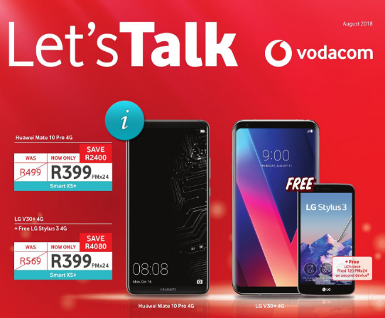
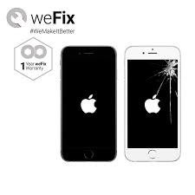
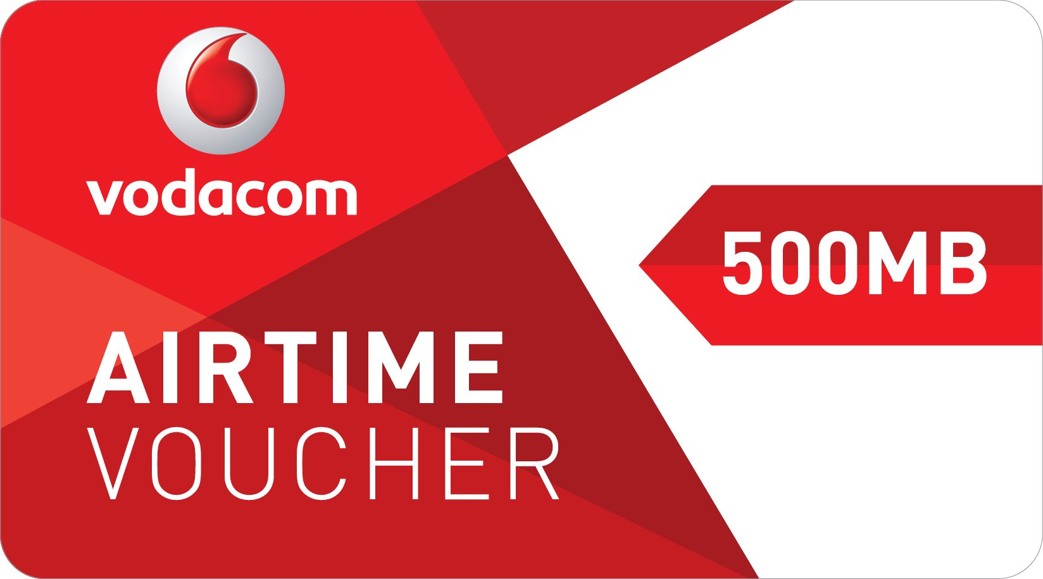
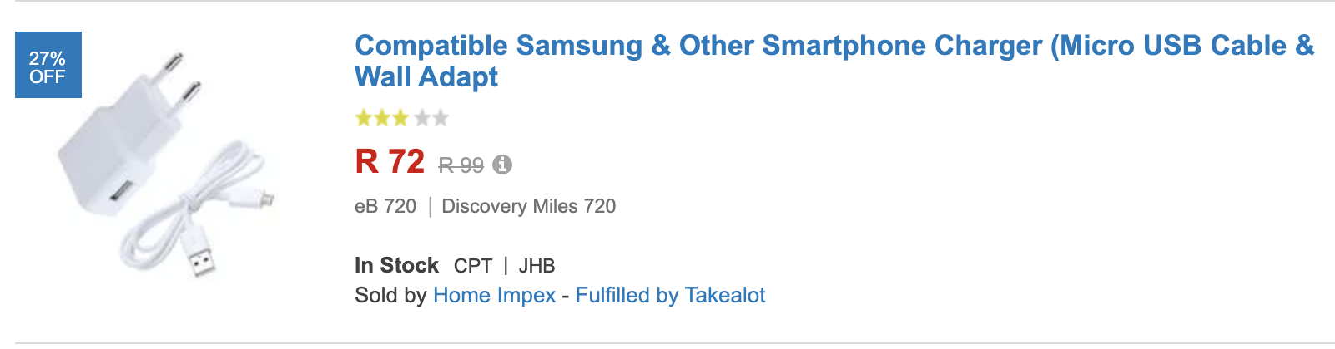
Think about the various business models for the following products
R499
Launch League Green
Notes:
How do the models shown here offer value and make money? [Ask participants to share some thoughts, or prompt them by starting on one or two yourself.]
Airtime voucher = pay-as-you-go. The airtime is more expensive that it would be on contract, but the customer can buy it as they need it.
Cellphone contract = subscription model. The customer has to pay a fixed sum, but gets the services cheaper. This model is less onerous for the supplier to manage and also guarantees retention.
Repairs = Transaction model: The customer gets to extend the lifespan of their device at a location that is convenient to them, and usually cheaper and quicker than the “official” suppliers.
Online shop = marketplace model: Customers can compare various cellphone accessories and buy a good-enough product at a better price. Suppliers can compete across different variables (price, accessibility, quality) to appeal to different customers.
Airpods = add-on model: Customers are in love with their iPhones and want the latest tech, design and status symbol from Apple. Apple generates more revenues and increases customer loyalty.

Slide 9
Business models
Most businesses focus on ONE business model:
Direct sales model
Add-on business model
Marketplace model
Pay-as-you-go model
Subscription model
Transaction model
There are many different business models and a lot of information is available online.
Launch League Green
Notes:
[Choose 2 or 3 of the models described to explain to the participants, based on their interests / businesses if possible.]
Direct sales model: Under a direct sales business model, sales of products or services generate revenue through a network of salespeople, who sell directly to customers. There’s usually no “shop” involved, rather individuals are given entrepreneurial tools and supported with marketing materials. Example: Avroy Shlain cosmetics sales.
Add-on business model: Fees or charges that are added to the basic price of a good or service for additional features or benefits, such as those added to the price of a car for accessories. The real key is to add on high-margin products or services. Example: Mags on a car.
Marketplace model: An online marketplace is basically an eCommerce website or an application which organises the products and services of different companies/sellers and sell them on its own website. The firm only acts as a mediator and doesn't own the products or services provided. Example: Takealot.
Pay-as-you-go model: Any type of payment structure in which a customer has access to potentially unlimited resources but only pays for what they actually use. Example: Airtime.
Subscription model: Subscription business models charge a customer a regular payment in exchange for access to products or services for a set period of time. Predictable recurring revenues is the most obvious benefit of this business model to the supplier.
Transaction model: The customer pays for what they get -- the business needs to make each new sale to the customer on its own merits (unlike the subscription model). Example: Most businesses, for example, a nail salon.
Often entrepreneurs starting a tech or app business think that they will acquire customers through a freemium model or generate
Fremium: Under a freemium model, a business gives away a service at no cost to the consumer as a way to establish the foundation for future transactions. The freemium model tends to work well for Internet-based businesses where it's cheap to acquire customers, and those who convert to paying will pay well over a long period of time. The service and choices available have to be extremely competitive. Example: Spotify.

Slide 10

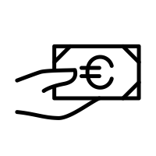

Let’s revisit our example….
Amaizing Briquettes provides an affordable alternative to unhealthy and unsustainable energy sources used for cooking on fire. It sells to retailers and organisations such as school feeding schemes.
Can you spot their business model?
R
Briquettes made out of maize waste sourced from farmers
Retailers and other organisations buy the briquettes
Households and chefs cook with the briquettes
Launch League Green
Notes:
Amaizing Briquettes charges buyers per bag. Buyers pay cash at every lesson. Amaizing Briquettes has a transactional business model.

Slide 11

Let’s revisit our example….
Amaizing Briquettes sells affordable, sustainable, and healthy briquettes to other ogranisations, such as retailers.
R
The briquettes come in bags of 5kg costing R40 each, and customers must buy a minimum of 10 bags.
If they pay in advance for 10 bags they receive one bag free.
Launch League Green
Notes:
Amaizing Briquettes charges buyers per bag. Buyers pay cash at every lesson. Amaizing Briquettes has a transactional business model.

Slide 12
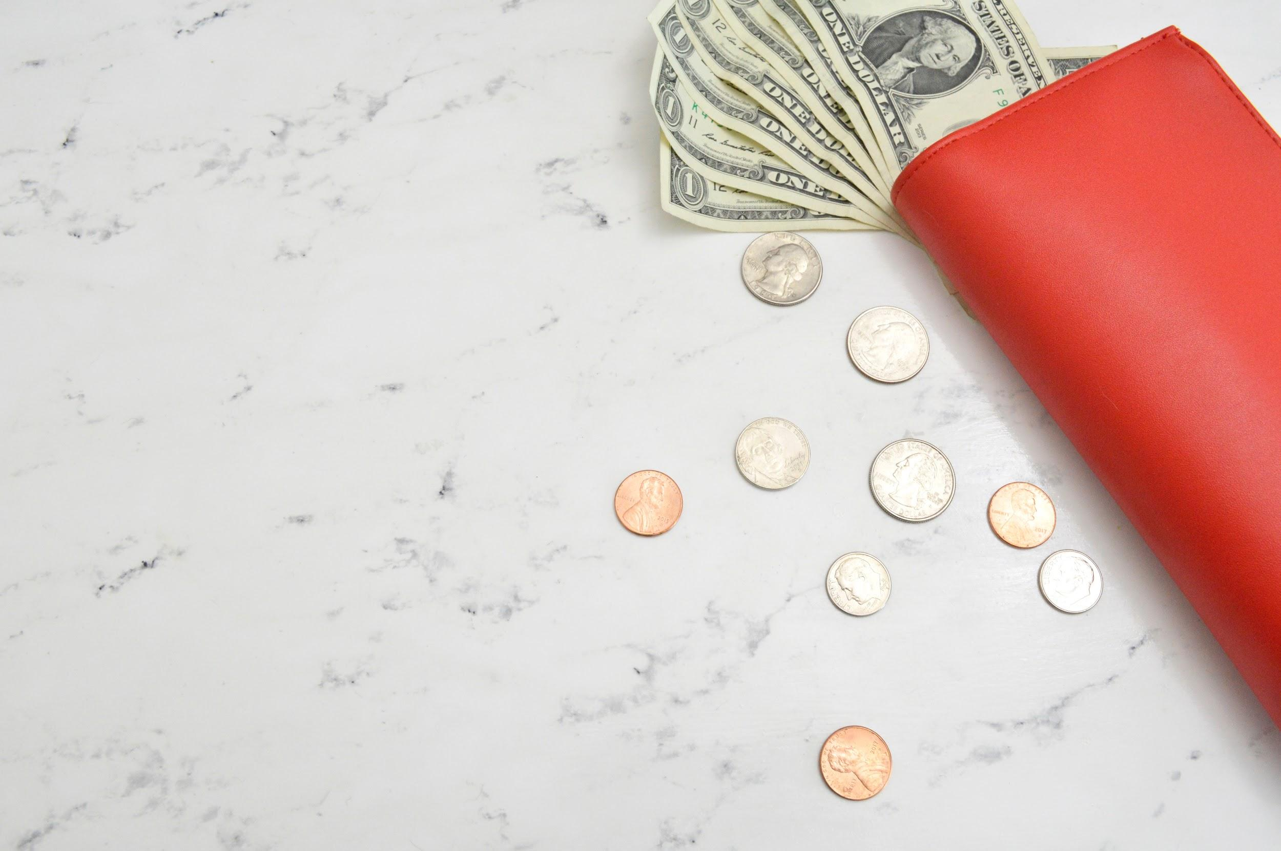
2.
Income
Launch League Green
Notes:
Right, let’s get to the good stuff!
[Question for the audience: Who of you likes to think about the money your business make? [People will put up their hands] Who likes to think about how much it costs your business to make that money? Who of you likes to spend time with the Excel spreadsheet of your Income statement? Who likes to think about how much tax you might need to pay at the end of February and why? [Probably very few people!]]

Slide 13
If you don’t understand the details of your business, you are going to fail.”
Jeff Bezos
Launch League Green
Notes:
A lot of people consider the details of how their business makes and manages money to be boring or secondary.
Listen to Jeff Bezos (founder of Amazon): a man worth $114 billion can’t be wrong.
Be like Jeff!

Slide 14
Income
Now that you have a better idea about business models, how are you going to generate income?
Income is any money that is paid to you for sale of products, services, rent or even interest on money you’ve saved.
Launch League Green
Notes:
[Read definition on slide.]

Slide 15
Let’s revisit our example….
Amaizing Briquettes sells affordable, sustainable, and healthy briquettes to other ogranisations, such as retailers.
R
The briquettes come in bags of 5kg costing R40 each, and customers must buy a minimum of 10 bags.
If they pay in advance for 10 bags they receive one bag free.
Launch League Green
Notes:
Amaizing Briquettes takes R40 from pupils when they attend a lesson.
Here you can see that Amaizing Briquettes have gotten clever by offering a subscription-like model -- a discount for buyers who pay in advance -- which helps them get more reliable revenue.

Slide 16
Cost of sales
When you think about income you also need to think about what it costs to deliver your product or service to your customer, before you have any income left to pay yourself!
This cost, which is directly associated with each product or solution sold is called your cost of sales.
Sales (or Income) - Cost of Sales = Gross Profit!
Gross Profit is what's left for you to cover the costs of your business (your overheads).
Launch League Green
Notes:
[Talk through what’s on the slide - pause to ask whether there are any questions or comments.]
[You may want to give some other examples of cost of sales.
For a business making bread, the ingredients and packaging of the bread would be part of their cost of sales.
For a business selling trendy T-shirts, buying the T-shirts, printing the design on it and paying commission to the “influencers” selling it would be part of their cost of sales.]

Slide 17
Monthly income
Once you understand the basic mechanisms of how your business generates income and what the costs associated with generating income are, you can
start to forecast monthly income (work out how much money you could
make per month).
For Amaizing Briquettes, if they sold 300 bags a week, what would their gross profit per month be?
Launch League Green

Slide 18
Income vs Gross Profit
For Amaizing Briquettes, how much money are they receiving from customers every month?
R40 x 300 bags sold x 4 weeks = R48 000 per month
But, remember, you are actually only retaining R100 per 10 bags, because of the costs to develop them:
GROSS PROFIT:
R10 x 300 bags x 4 weeks = R12 000 per month
Launch League Green

Slide 19
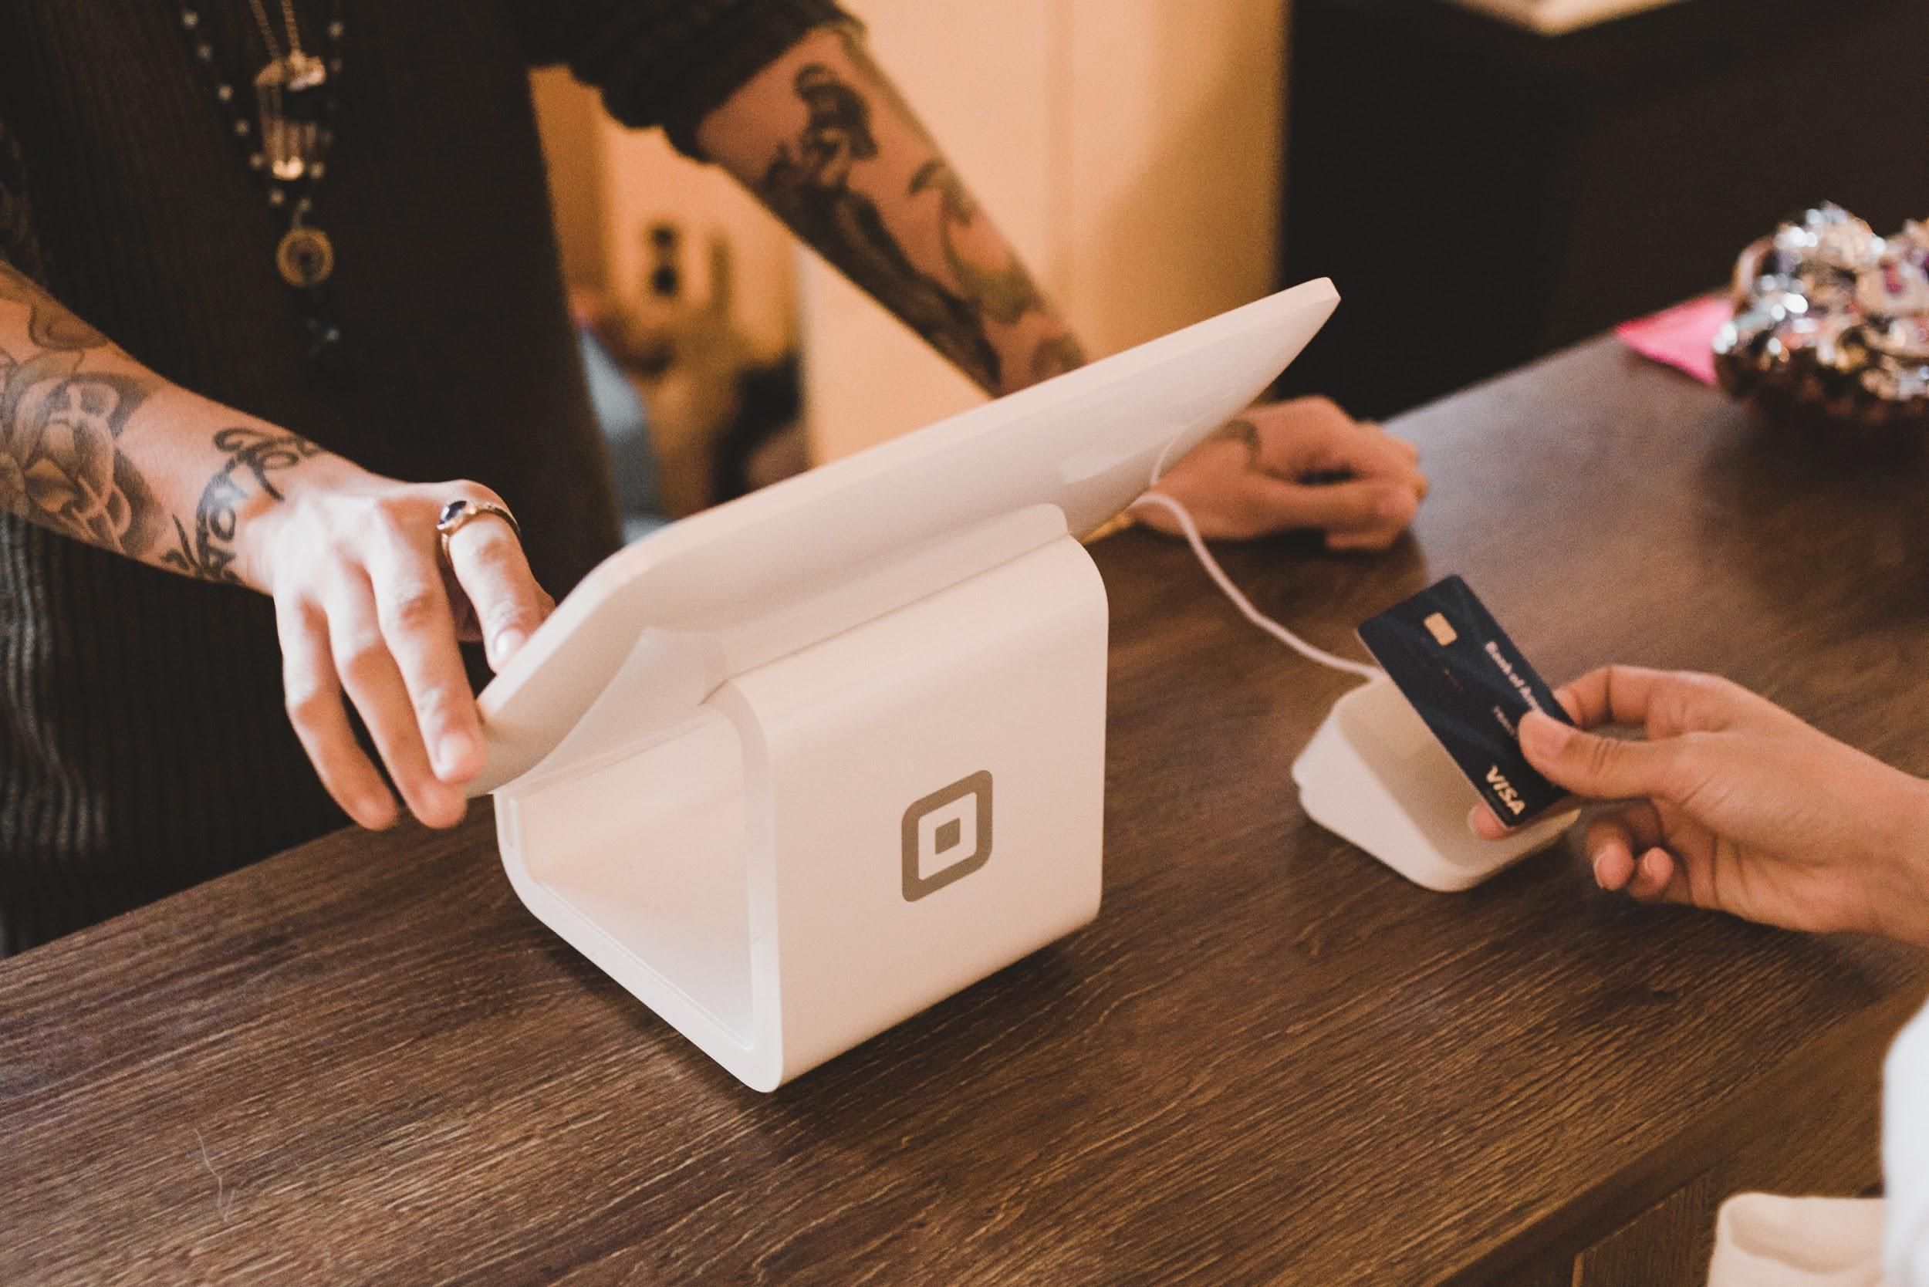
3.
Costs
Launch League Green

Slide 20
Overhead costs
Overhead costs are basically anything that you need to pay to keep your business running. Most overhead costs are incurred on a monthly basis,
but some can be incurred annually.
These could include the following:
Accounting & bookkeeping fees
Bank charges
Printing & stationery
Rent
Telephone & internet
Office expenses
Utilities
Subscriptions
Travel
Salaries
Tax
Marketing
Launch League Green
Notes:
Costs to run your business -- or overhead expenses -- are different to cost of sales in that they keep getting incurred whether you produce products and services, or not. It is important to not only plan for these costs, but to keep them under control, so that you can ride out dips in demand for your product.

Slide 21
Monthly costs
Amazing Briquettes keeps its monthly costs low, but they still add up:
COST | AVERAGE AMOUNT P.M.
Bank Fees & Accounting | R 300.00
Raw materials | R 2 000.00
Water | R 200.00
Telephone & Internet | R 300.00
Salaries | R 8 000.00
Electricity | R 500.00
Travel | R 500.00
Insurance on equipment | R 200.00
TOTAL | R12 000.00
Launch League Green
Notes:
[Go through the costs briefly -- then ask participants: “Is Amaizing Briquettes making or losing money?” The answer… breaking even!]

Slide 22
Break-even
INCOME
NET PROFIT
BREAK
EVEN
POINT
PROFIT
OVERHEAD COSTS
GROSS PROFIT = OVERHEAD COSTS
LOSS
TIME
Launch League Green
Notes:
You may have heard people referring to a business breaking even.
Break-even happens when your gross profit is equal to your overhead costs.
In other words, you first need to get your pricing right, so that the revenue you are receiving from customers is more than what it takes to deliver your product or service: this is called your gross profit.
If you are making enough from your sales to customers that you can also cover your overhead costs, then you have broken even.
When you can make enough from your sales to cover your cost of sales and pay your overheads, with some left over, then you are making a real profit! This is called your net profit.

Slide 23
Break-even analysis
Is Amaizing Briquettes profitable? And how many bags do they have to sell to cover the monthly costs of the business?
Monthly Costs = R12 000.00
Gross profit per bag = R10.00
Number of bags that need to be sold per month = R12 000.00 / R10.00
= 1200 (300 bags a week)
R10 x 1200* = R12 000 per month to break even.
(*bags per week x weeks in a month)
How could Amaizing Briquettes become more profitable?
Launch League Green
Notes:
[Talk through this slide. Ask whether everyone understands it.]
Q for participants: How could Amaizing Briquettes become more profitable?

Slide 24
Profit
Many factors affect profits in a business, but you could consider the
following mechanisms to increase profit:
Increase prices
Increase gross profit by decreasing costs of sales
Increase sales
Decrease monthly costs (overheads)
Just be careful that you don’t compromise on the value you provide to your customers!
Launch League Green

Slide 25
Costs
As your business grows your costs will grow too! You need to think about what additional costs your business will need to cover:
Professional services
Tax
Subscriptions
Office space for more staff
Salaries
Stock
Travel
Additional marketing
Business development
Insurance
Finance costs
Launch League Green

Slide 26

Your turn!
Launch League Green
Notes:
We are going to work on the income and costs blocks on your canvas now.

Slide 27
Business model & income
Using the business model and income worksheet, describe your business model and how you create, deliver and capture value. Use the template to understand how you generate income and what your cost of sales are, if any.
Once you have a first version of your business model and income model, test it by reading it out to someone. Ask them if they understand your business model and how you generate income.
Once you understand how you are generating income, complete the income block in your canvas.
Launch League Green

Slide 28
Costs & break-even analysis
Using the costs and breakeven analysis worksheet, list your costs to understand what you need to pay for each month to run your business, as well as a breakeven analysis to understand what your minimum monthly income or sales need to be.
Once you have a first version, test it by reading it out to someone. Ask them if they understand your costs and your break-even analysis.
Once you understand the costs in your business, complete the costs block in your canvas.
Launch League Green

Slide 29
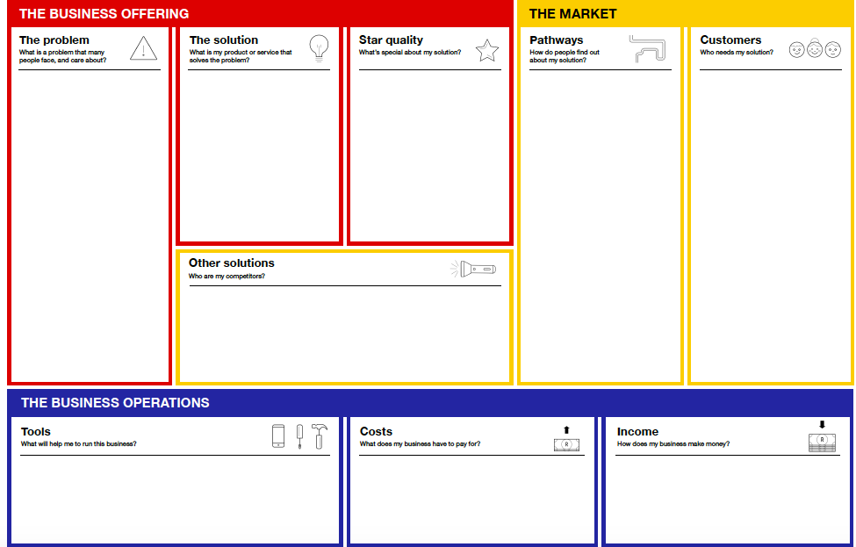
Many SA households and organisations use or rely on burning coal, wood, perofene, or gas to cook.
These are unhealthy, unsustainable, and set to become less affordable.
The existing alternative are typically pricy, such as eco-friendly briquettes at high-end grocery stores.
Meanwhile, maize crops create a lot of unused waste which can be turned into briquettes.
Amaizing Briquettes sources maize waste from 15 local farmers, processes it into briquettes, and then sells it to retailers and a local school’s feeding scheme.
Sourcing maize waste allows the business to create affordable briquettes.
It is better for the health of households and chefs, which people value due to the prevalence of respiratory problems in South Africa.
Free social media platforms, especially Facebook, Twitter, and Instagram.
Setting up meetings with store owners & school principals to discuss how they can work together.
Advertising on and in taxis, as well as posters in train stations and taxi ranks - it's likely that your target audience will use these to travel and will be stuck in queues.
Retailers, such as spaza shops, grocery stores, and petrol station shops. All located in or around Mbombela.
Organisations such as school feeding schemes who service vulnerable groups. All located in or around Mbombela.
Users: Households and chefs of various income groups, through primarily those who want affordable, healthy briquettes.
Amaizing Briquettes
Direct competitors are either unsustainable/ unhealthy or expensive.
Substitutes or indirect competitors include electricity services, though these are currently expected to become more expensive and less accessible.
Cost of sales include sourcing maize waste, processing it, and packaging it.
Overhead costs include salaries, insurance, travel expenses...
Income is generated through selling bags of briquettes to customers.
Launch League Green

Slide 30
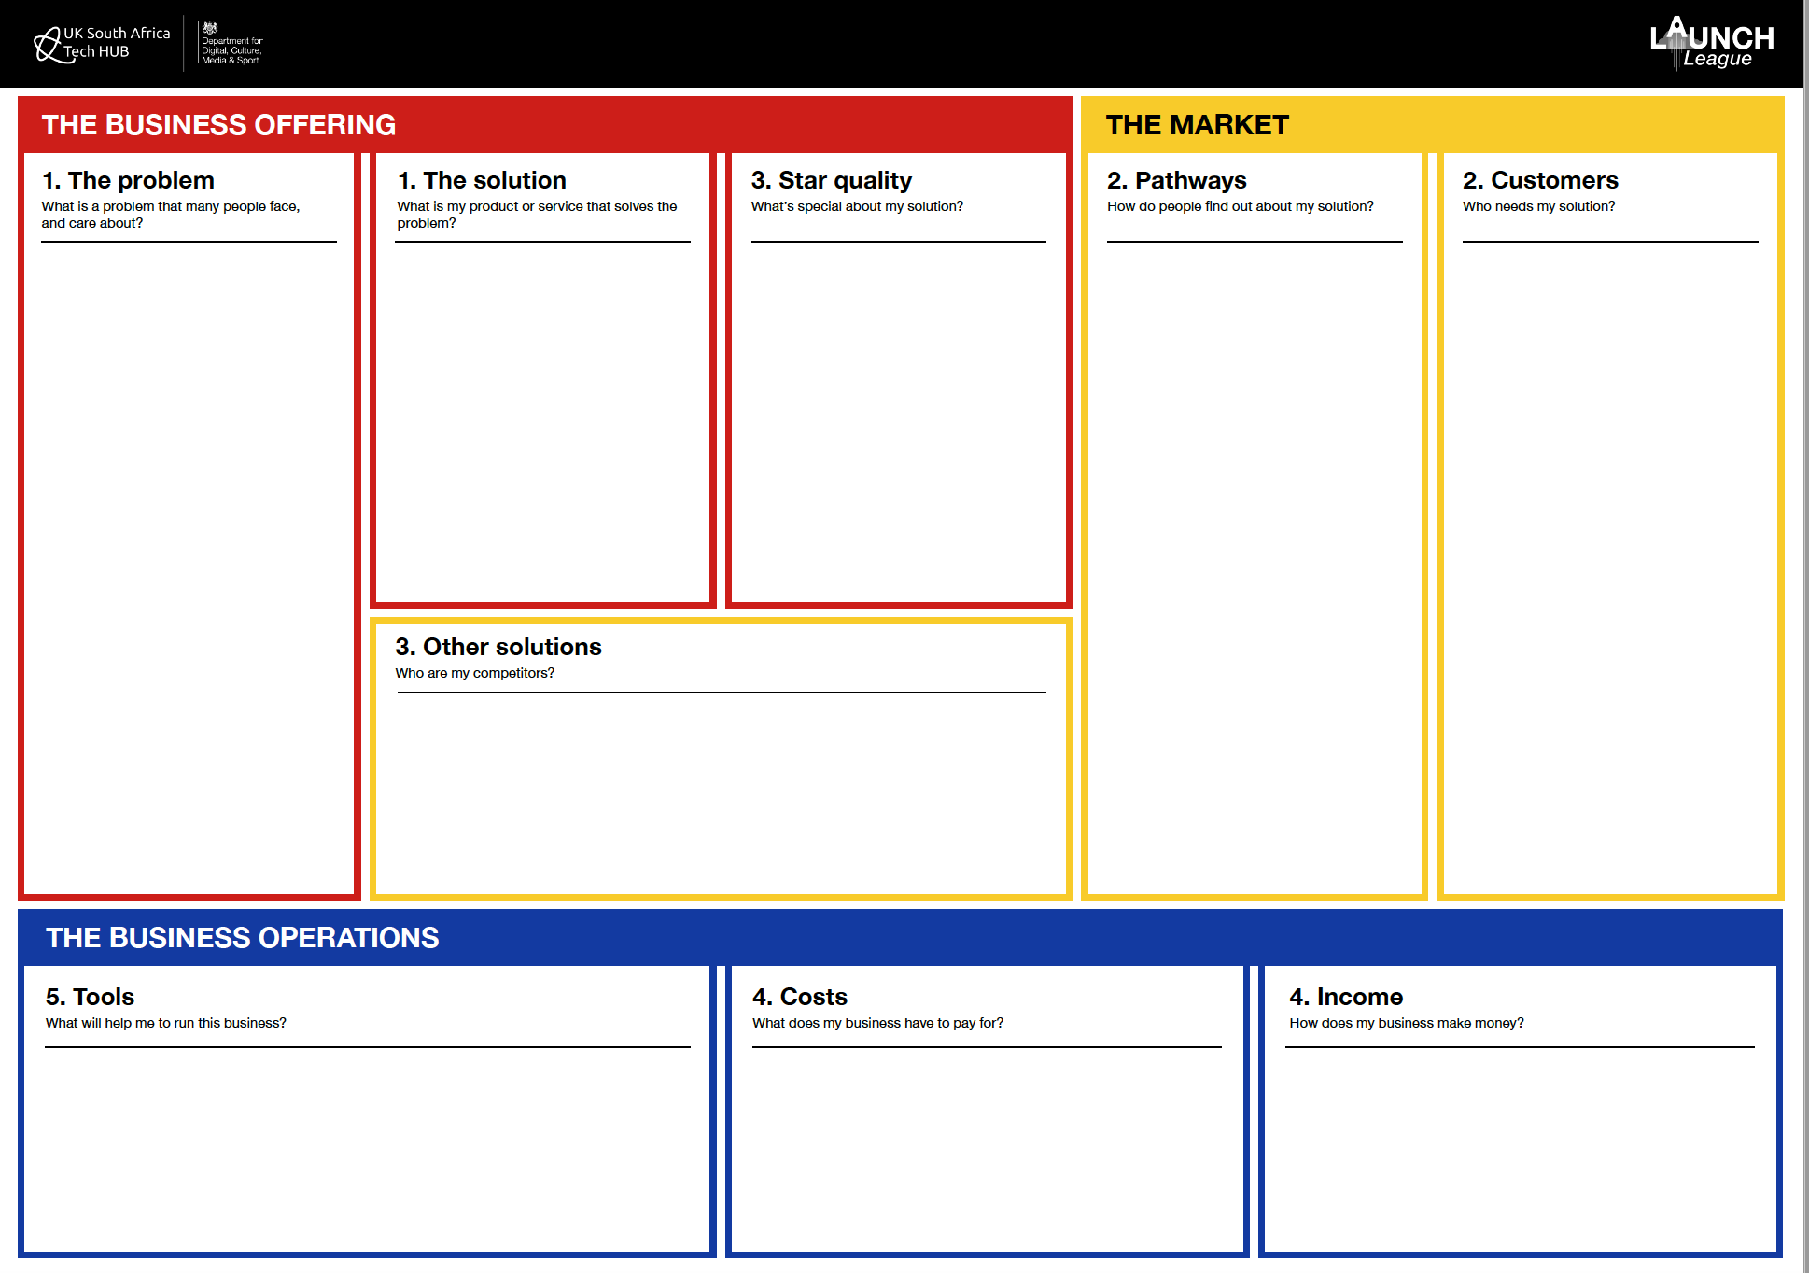
Launch League Green
Notes:
Once you have completed your Income and Costs worksheets, you can enter these into your canvas.

Slide 31
4
3
TT
2
1
i
Notes:
Congratulations on making it this far! One more tech tools session and one more module, and you’ll finally be a Launch Leaguer!

Slide 32
MODULE 4:
How do I make money?
Launch League Green

