Slide 1


MODULE 3:
How do I get my customers to choose me?
Launch League Green
Notes:
In module 3, we will discuss how to convince customers to choose your business -- how to communicate the value of your solution.

Slide 2

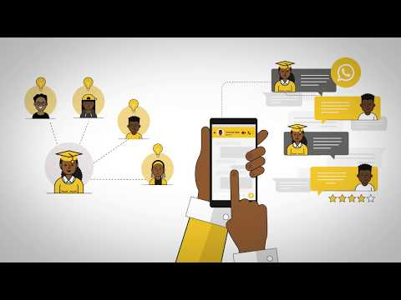
Launch League Green
Notes:
NOTE: this video uses the original Launch League business example, ABC Tutors. It is a relatable example that can still be useful to your entrepreneurs, but take extra care to explain the same concepts using the Launch League Green green economy example, Amazing Briquettes.
https://www.youtube.com/watch?v=H0FOB6czWYY
Let’s recap this video from yesterday, exploring the market part of your canvas. In this module, we’ll be exploring your business’ star quality and also your competition -- which you will then enter into your canvas.

Slide 3

What is Launch League?
This programme material was originally developed by the British High Commision UK-South Africa Tech Hub and Viridian through the Launch League initiative.
Launch League creates material and training/ networking opportunities for South African hubs and training organisations, so that we can better support YOU – promising entrepreneurs from our community!
www.launchleague.co.za
Launch League Green

Slide 4
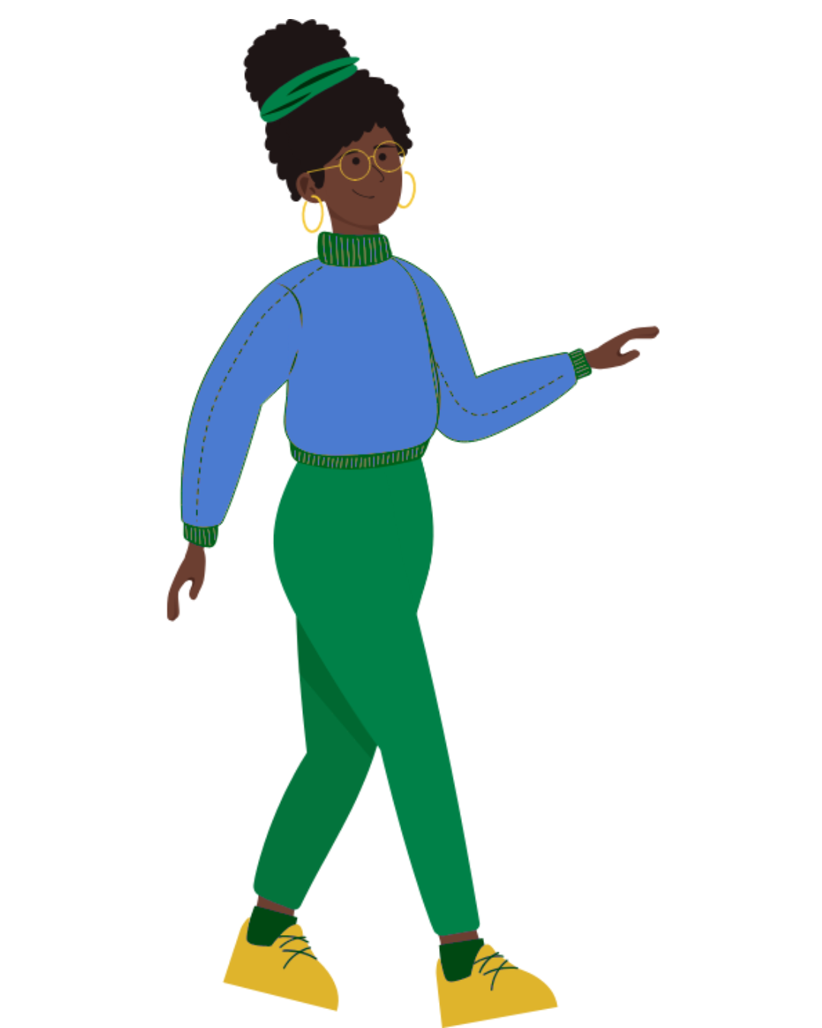
What is Launch League Green?
Businesses that have environmental sustainability at the heart of their model can not only create significant impact in our communities by solving pressing challenges, but they also have significant potential for growth and job creation due to investment interest and allocation.
Launch League Green is a programme Viridian ran in mid-2025 for entrepreneur support teams to increase their knowledge and networks to run specialised programmes for green entrepreneurs in their communities. This version of the Launch League idea-stage programme uses an example of a green business to inspire entrepreneurs in the green economy!
Launch League Green

Slide 5

1.
Creating value
Launch League Green

Slide 6
Care enough to create value for customers. If you get that part right, selling is easy.
Anthony Iannarino
Launch League Green
Notes:
If your product or service is valuable to customers, they will be willing to pay for it. This is why you should always keep your customers top of mind when making any decisions for your business.

Slide 7




How do you create value for your customers?
VS
VS
Launch League Green
Notes:
Leading businesses choose different and unique ways to create value for their customers, which makes them different to their competition.
Looking at this example,
Virgin Atlantic creates value for their customer by offering state of the art on-flight entertainment and wifi access, great equipment and planes other perks for joining their club / while FlySafair creates value for their customers by ensuring their flights are affordable and easy to book.
{Question for group -- how do Apple and Samsung create value for their customers? How are they different?}

Slide 8
Creating value
Most businesses create value for their customers by focusing on ONE of the following factors:
Being CHEAPER (more affordable)
Being BETTER (increased quality)
Being FASTER (saving time)
Being NEW (novelty or innovation)
Being ACCESSIBLE (local)
Launch League Green
Notes:
{Run through each of the value factors}
Accessibility is an important factor consider, particularly if you are delivering a product or service online. In South Africa, we need to seriously consider data costs, but also digital literacy. Your customers may all have smartphones, but how well can they use them?
{How many of you are going to be cheaper/ better/ faster?}
Remember, at this point in your business, you should be choosing one customer group and one main value add.
Don’t get confused by your users, focus on your customers!

Slide 9
Let’s revisit our example….
Amaizing Briquettes sells briquettes made out of maize waste to retailers and other organisations. Those who use the briquettes are households and school cooks. Maize briquettes are healthier to use for cooking than other types of fuels. They are more affordable than electricity.
Can you spot their competitive advantage or star quality? Would you be able to create a value proposition statement for your business?
Launch League Green
Notes:
{Run through the example.}
This is Amaizing Briquette’s value proposition – it describes the value that they create for their customers. Understanding your core value to customers is very important to ensure your marketing is effective.
{Question for the group – what do you think their competitive advantage is? What makes them different? What is their star quality?}

Slide 10
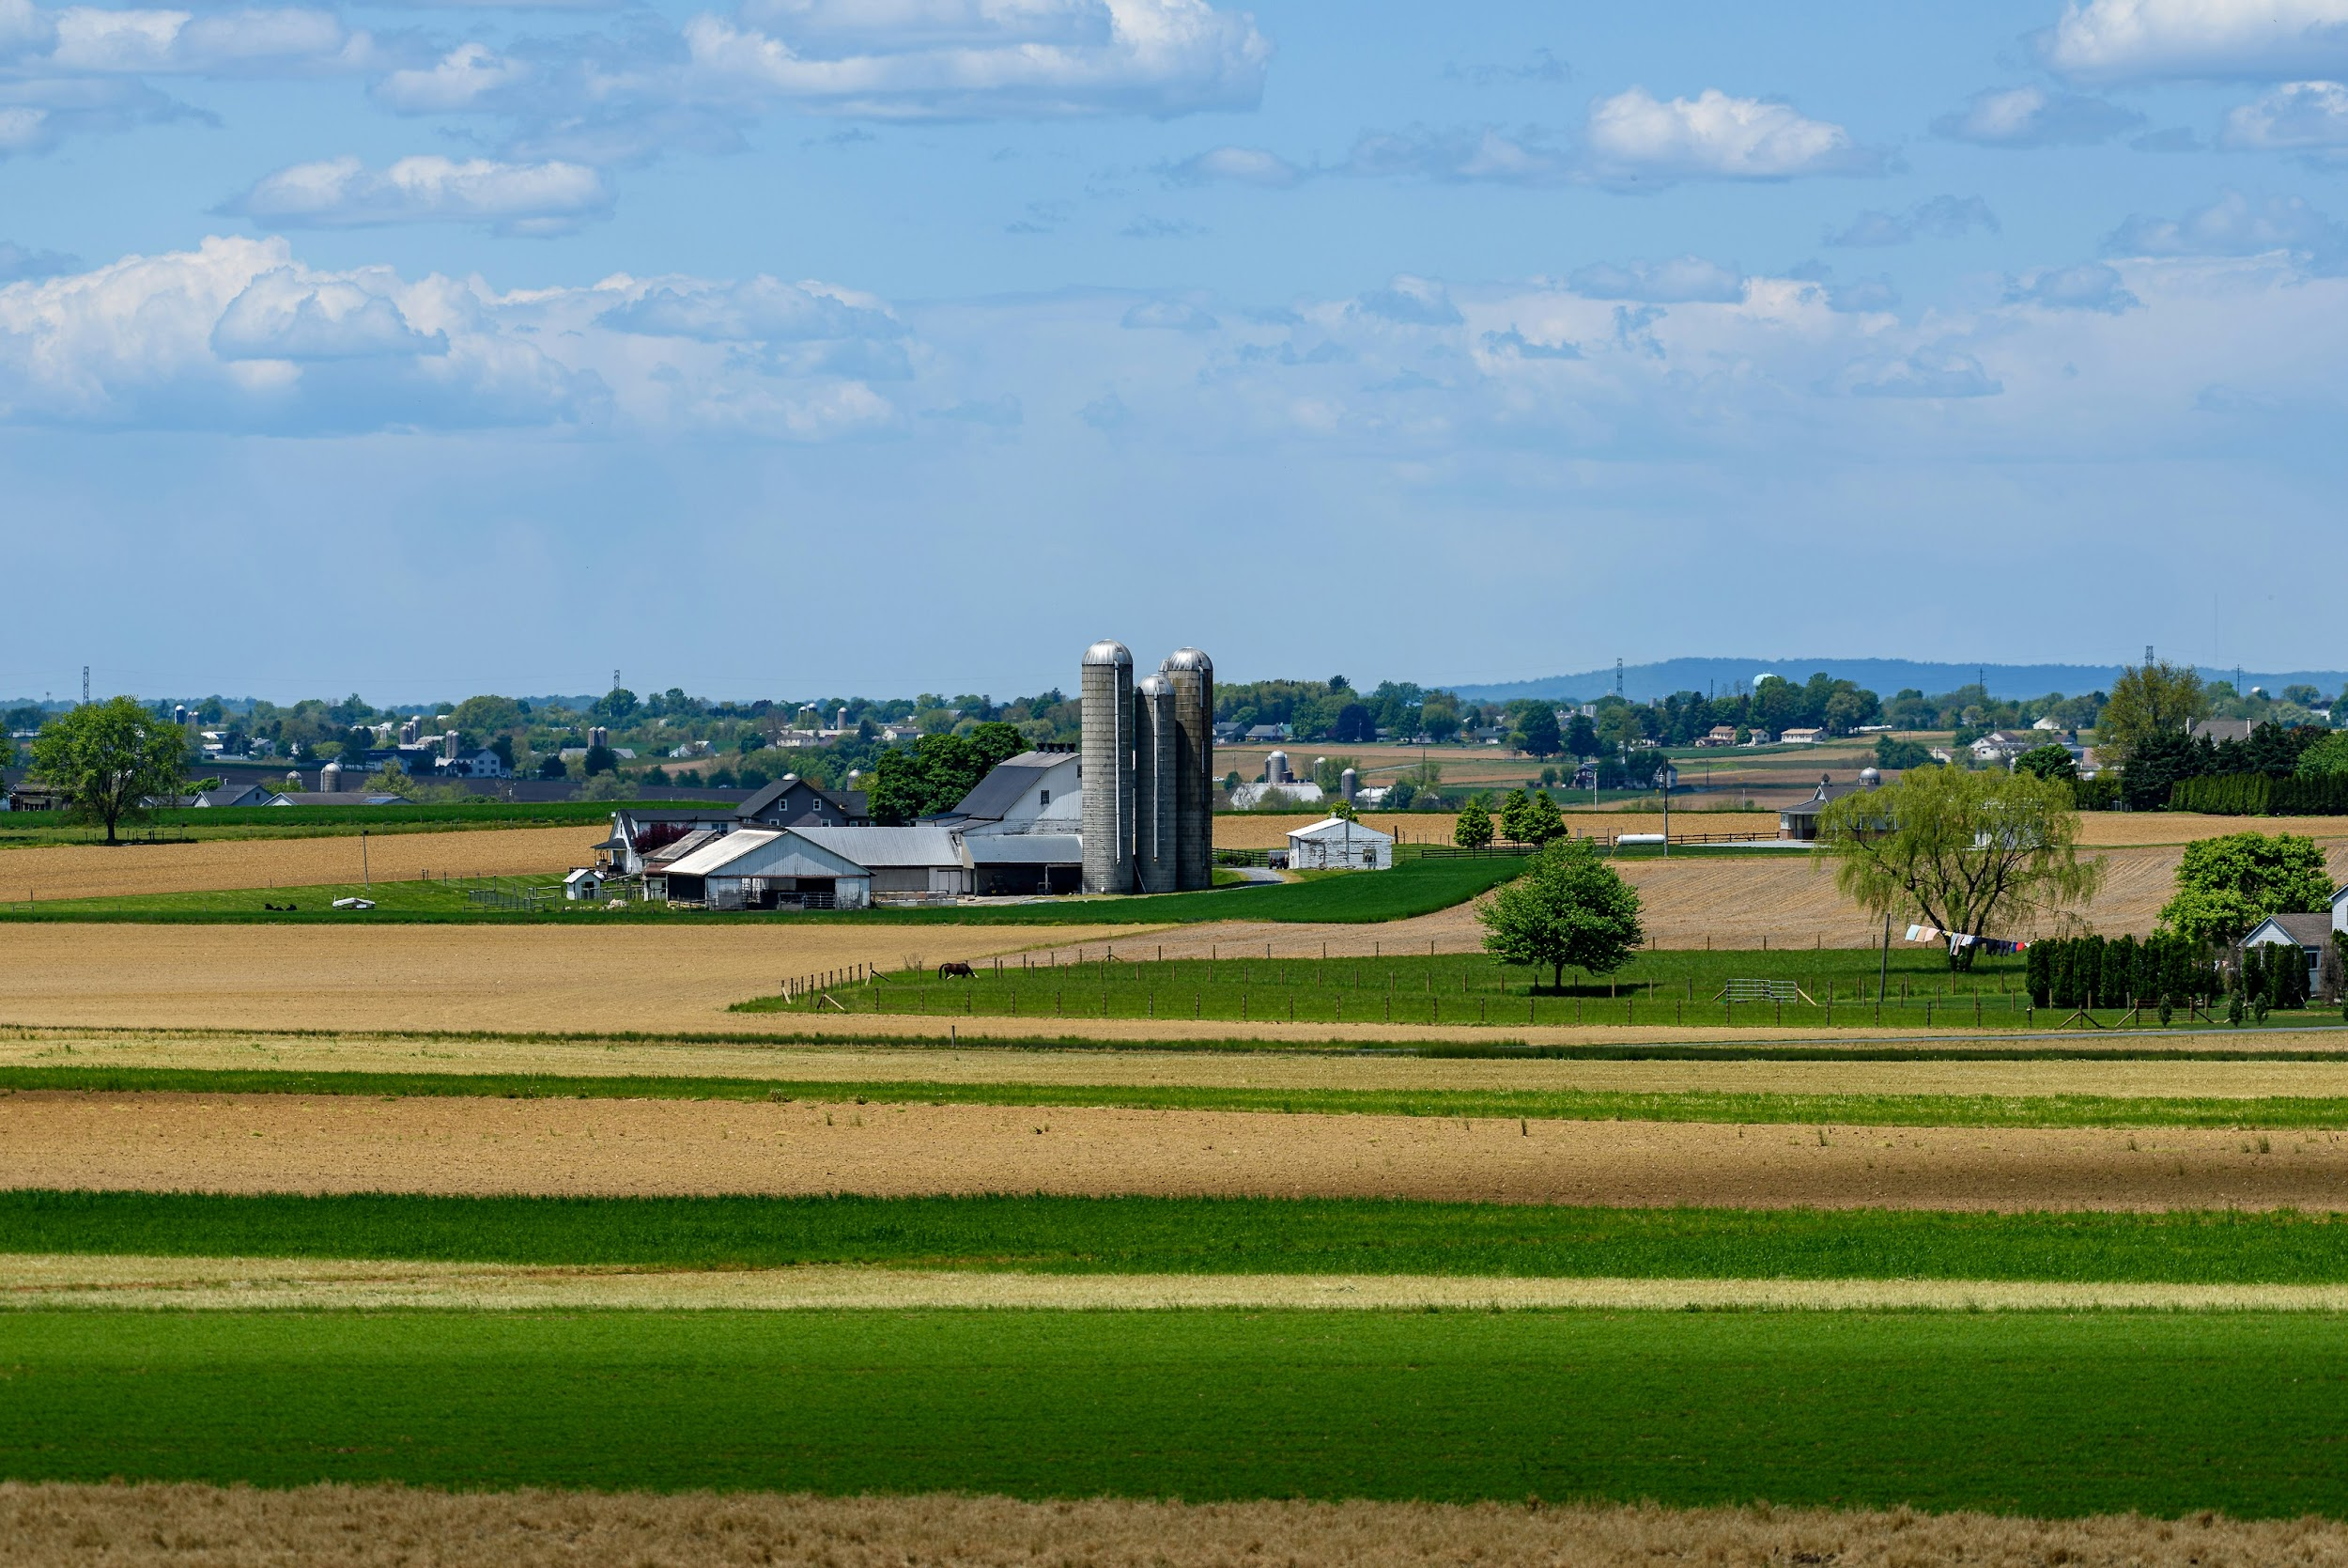
2.
Competition
Launch League Green

Slide 11
Competition
How do you define a competitor?
A competitor is ANYTHING that solves the same problem or need as your business! It is also anything that can be a substitute for your product or service.
Launch League Green
Notes:
{Read through slide}
{Question for group - who / what is your business’ biggest competitor? And do you know ALL your competitors?}

Slide 12
Competition
There are ALWAYS competitors to any business!
Competition can be:
Direct or Indirect
Local or Global
Online or Offline
Launch League Green
Notes:
{Speak through each line}
Direct competitors offer the same thing as you. E.g. McDonalds & Burger King. Indirect play in the same space but offer something to the same audience that solves their problem in a different way. For instance, Spar food delivery service.
Local and global competitors may be relevant, particularly when it comes to technology products or services.
You also may face online and offline competitors -- for instance you may be a shop facing competition from Takealot.

Slide 13
Competition
You can better understand and rank your competitors using a table.
This also allows you to understand your competitive advantage! This should be aligned to the value you create for customers.
Launch League Green
Notes:
To understand your competitors, you’re going to need to list them.
You have many competitors, and you need to think broadly to create your list. If you have an innovative solar powered lamp that you’ve developed for customers during load-shedding, you should consider all solar-powered lights, battery powered lights but also candles!
You can then assess your competitors by comparing yourself to them on the value you create for customers.

Slide 14
Competition
Amaizing Briquettes competes against traditional sources of fire (such as wood, coal, paraffin, and gas), as well as eco-friendly alternatives (such as briquettes made of other waste materials). One could also argue that they compete against electricity for cooking - if electricity is more affordable, reliable, and easily available, then households may use less fire to cook.
Launch League Green
Notes:
We’ll go back to Amaizing Briquettes as an example. {Read through example}

Slide 15
Dispelling the myth of green luxury
‘Sustainable’, ‘green’, ‘eco-friendly’, and ‘healthy’ are marketed as luxury. This suggests that it is more expensive and harder to access.
Some people also criticise sustainable products for being of lower quality.
However, many sustainable and healthy products are not necessarily more expensive, inaccessible, or lower quality than their unsustainable alternatives.
Amaizing Briquettes, for example, is cheaper to produce because it takes waste that would otherwise be thrown away or used for feed.
Launch League Green
Notes:
We’ll go back to Amaizing Briquettes as an example. {Read through example}

Slide 16
Why choose the green option?
When marketing a product, try to focus on what makes it cheaper, better, and/or quicker to buy/use.
When communicating the benefits of a green product, bring the conversation down to the customer/user’s daily needs and concerns.
For example, ‘Amaizing Briquettes burns with less pollutants than other products’ is a vague competitive advantage. It would be better to say ‘Amaizing Briquettes do not have a strong smell and will not cause you to cough, unlike other products.’
Launch League Green
Notes:
We’ll go back to Amaizing Briquettes as an example. {Read through example}

Slide 17


Competition
Company | Price | Location | Healthy - people won’t cough | Ease of sourcing/ purchasing | Flexible payment options
Amaizing Briquettes | R | Mbombela
Coal | R | Gauteng
Informally gathered firewood | None, but takes time and may be illegal | Mbombela
Green Ecobriqs | RRR | Gauteng
Launch League Green
Notes:
In this example, Amaizing Briquettes have looked at 4 of their competitors and compared on price, individual or group classes, location, target audience and whether customers can use WhatsApp and flexible purchasing options when ordering.

Slide 18

Your turn!
Launch League Green
Notes:
We are going to look at your star quality now, or your “competitive advantage”, as it is also called.

Slide 19
Creating value, or your star quality
Using the template on the worksheet, start crafting your value proposition. Really think about what your business’s star quality is. Try to keep it simple! (10 minutes)
Once you have a first version, test it by reading it out to someone. Then ask them to describe the value that you create for your customers -- your star quality. (10 minutes)
You might have to refine your value statement a few times, especially once you get feedback from customers!
When you are happy, complete the Star Quality block on your canvas.
Launch League Green
Notes:
{Individual worksheet - 5 minutes}
{Partner share - 5 minutes}
{Refinement + Canvas fill - 5 minutes}

Slide 20
Competitor analysis
Using the competitor analysis worksheet, look at what you are helping your customers do. Complete the worksheet. (10 minutes)
Once you have a first version, test it by reading it out to someone. Ask them if they know of any competitors that you might have missed.
(10 minutes)
Launch League Green
Notes:
Let’s start with your Target Customer. Please complete the worksheet, then discuss your competitors with a partner. The, complete your canvas.
{10 min + 10 min}

Slide 21
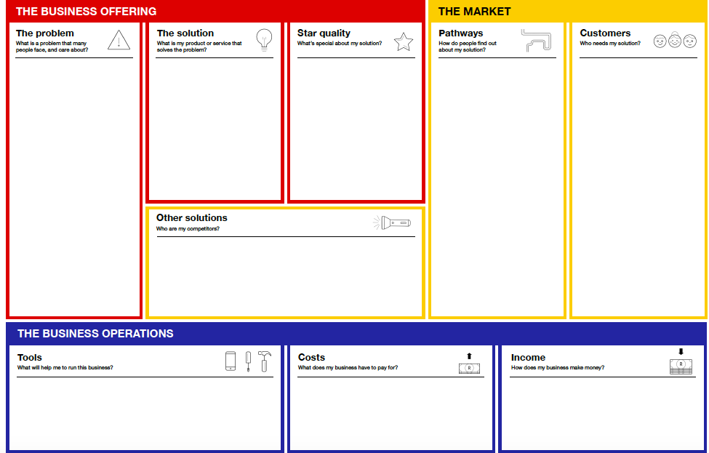
Many SA households and organisations use or rely on burning coal, wood, perofene, or gas to cook.
These are unhealthy, unsustainable, and set to become less affordable.
The existing alternative are typically pricy, such as eco-friendly briquettes at high-end grocery stores.
Meanwhile, maize crops create a lot of unused waste which can be turned into briquettes.
Amaizing Briquettes sources maize waste from 15 local farmers, processes it into briquettes, and then sells it to retailers and a local school feeding scheme.
Sourcing maize waste allows the business to create affordable briquettes.
It does not cause users to cough when burning it.
It is easy for customers to source.
It has several payment options.
Free social media platforms, especially Facebook, Twitter, and Instagram.
Setting up meetings with store owners & school principals to discuss how they can work together.
Advertising on and in taxis, as well as posters in train stations and taxi ranks - it's likely that your target audience will use these to travel and will be stuck in queues.
Retailers, such as spaza shops, grocery stores, and petrol station shops. All located in or around Mbombela.
Organisations such as school feeding schemes who service vulnerable groups. All located in or around Mbombela.
Users: Households and chefs of various income groups, through primarily those who want affordable, healthy briquettes.
Amaizing Briquettes
Direct competitors are unhealthy, expensive, and/or harder to source and pay for by customers.
Substitutes or indirect competitors include electricity services, though these are currently expected to become more expensive.
Launch League Green
Notes:
Once you have completed your problem and solution statement, you can enter into your canvas.

Slide 22
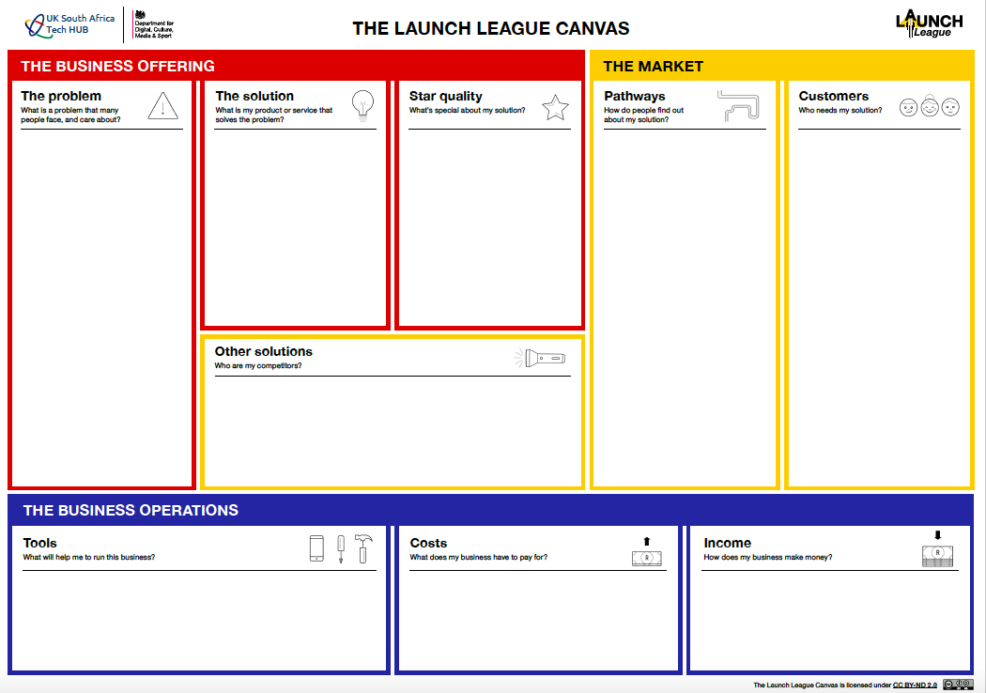
Launch League Green
Notes:
{Play video 3.}
Once you have completed value proposition and competitor worksheet, you can enter into your canvas under Star Quality and Other Solutions.
{Amaizing Briquettes Example on next page}

Slide 23
3
2
1
i
Notes:
We’ve finished up module 3, we have 2 more modules plus a tech tools session this afternoon. We now have a 15 minute tea break and will be back at 11.15 to start module 4.

Slide 24
MODULE 3:
How do I get my customers to choose me?
Launch League Green

