Slide 1


MODULE 1:
Is there a need for my product or service?
Notes:
Module 1 is going to look at whether there is a need for your business.

Slide 2

What is Launch League?
This programme material was originally developed by the British High Commision UK-South Africa Tech Hub and Viridian through the Launch League initiative.
Launch League creates material, and training and networking opportunities for South African hubs and entrepreneur support organisations, so that we can better support YOU – promising entrepreneurs from our community!
www.launchleague.co.za
Launch League Green

Slide 3
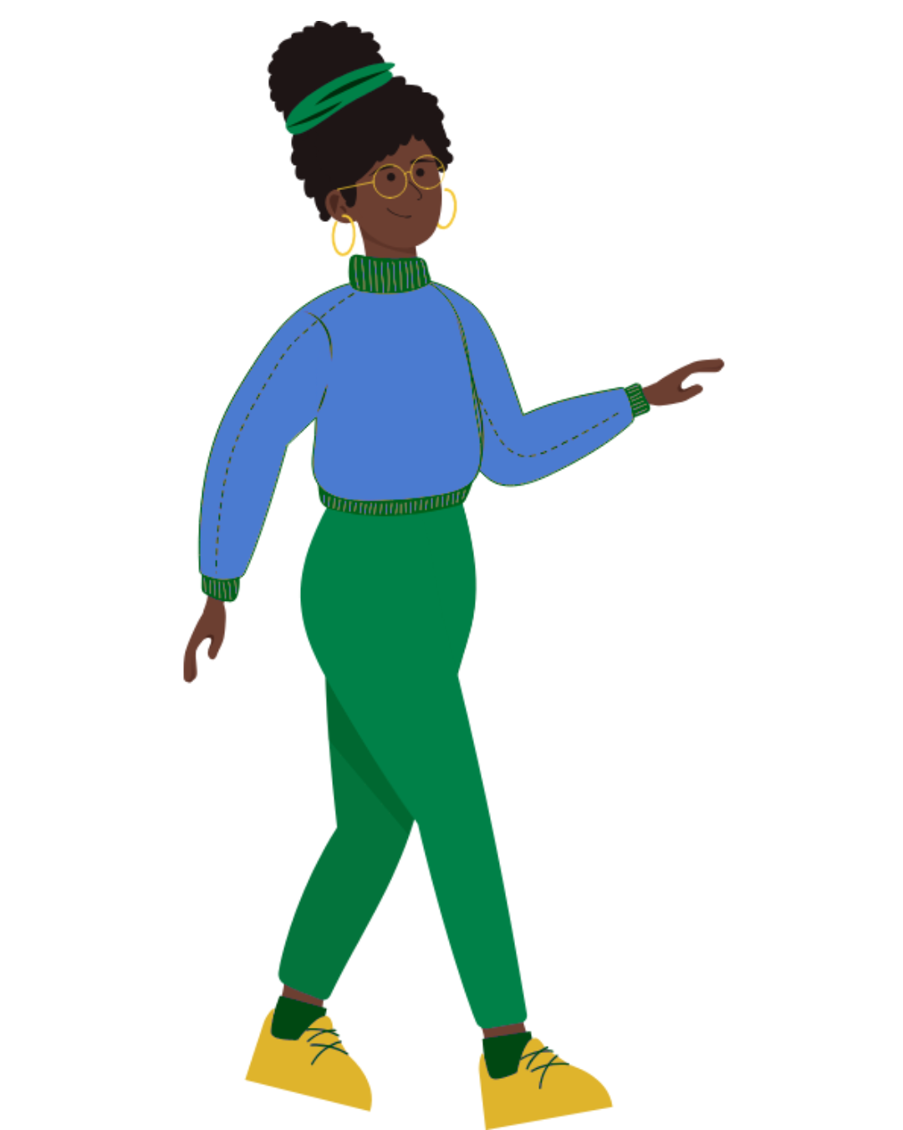
What is Launch League Green?
Businesses that have environmental sustainability at the heart of their model can not only create significant impact in our communities by solving pressing challenges, but they also have significant potential for growth and job creation due to investment interest and allocation.
Launch League Green is a programme Viridian ran in mid-2025 for entrepreneur support teams to increase their knowledge and networks to run specialised programmes for green entrepreneurs in their communities. This version of the Launch League idea-stage programme uses an example of a green business to inspire entrepreneurs in the green economy!
Launch League Green

Slide 4
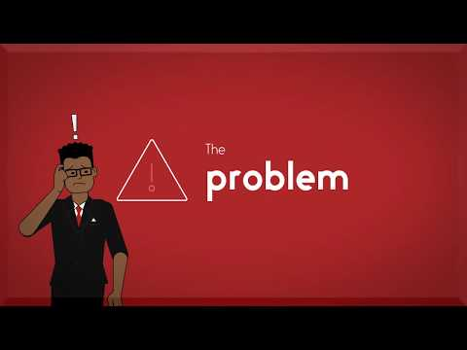
Launch League Green
Notes:
NOTE: this video uses the original Launch League business example, ABC Tutors. It is a relatable example that can still be useful to your entrepreneurs, but take extra care to explain the same concepts using the Launch League Green green economy example, Amazing Briquettes.
https://www.youtube.com/watch?v=S3zwb8eAb-U
This video explains the business offering section of your Canvas. {Allow a moment for everyone to look at their canvas}
At the end of this module, we will be able to complete two of the sections of your canvas relating to your business offering.

Slide 5
1.
Problem & Opportunity
Launch League Green
Notes:
Every business should solve a problem for its customers. We all face problems every day that we need solved. From big ones, like no electricity or internet because of load shedding, to small ones like running out of milk/ our children receiving poor marks for their maths tests at school.

Slide 6



Launch League Green
Notes:
{Question for group -- Think of these popular big businesses, what problems did they set out to solve? Discuss with person near you} {Allow 5 mintues}
{Yoco -- in SA, card machines from banks too expensive for small businesses, and they are missing opportunities because they cannot accept card payments.
Capitec -- South Africans were facing high banking fees, and it was time-consuming to do banking and often costly to visit branches. Netflix – South Africans wanted to be able to watch local and international content on demand and at a reasonable price}

Slide 7
Every business solves a problem.
Think about when you first had the idea for your business… what sparked the idea?
You experienced a problem yourself
Someone you know experienced a problem
What happened next?
Launch League Green
Notes:
How did you come up with the idea of the business?
Often it is because you experienced a problem or one of your friends, family or colleagues experienced a problem.
Once you identified a problem, you probably started thinking about a solution and looking around at who else is solving this problem. It is so important that entrepreneurs really understand the problem they are solving.

Slide 8
But is there an opportunity?
If there is a group of people or businesses who experience the problem, care about the problem, and are willing to pay to have it solved for them, there is a market need and an opportunity.
Launch League Green
Notes:
Once you’ve identified a problem, you need to understand if there is an opportunity for a new business (people will pay for it) to solve this problem, and if there is opportunity for you to run the business.
If many people need the solution and they need it repeatedly and they will pay to have their problem solved, then there is an opportunity.
If you have the right skills, connections and determination to deliver a solution, then there is an opportunity.

Slide 9
The number one reason for businesses failing (42%) is because there is no market need.
CB Insights
Launch League Green
Notes:
{Example: Mpesa/ mobile money in South Africa - it is very successful in East Africa because majority of people do not have bank accounts and therefore need ways to make transactions. In SA, we have a developed banking system and most people have a bank account -- there was little market need for a mobile money solution.}

Slide 10

To really understand the opportunity, you first need to ask yourself a few questions.
Is it one problem or many problems?
Do lots of people really care about this problem? Or is it more of a “nice to have”?
Are you confident that you could build a business around this problem?
Launch League Green
Notes:
{Run through each of these questions with the group}
A business should solve one core problem initially.
This describes need vs want. Also, can you convince someone that they need it? This can change --- use UPS and generator example.
This relates to the skills, experience and networks you have/ don’t have that will help you solve this.

Slide 11
Problem statement
Allows you and others to understand why your business exists.
It describes the problem and need for your business in a few sentences & who experiences the problem – local and specific.
What is the problem? Why is it an opportunity?
How big is the opportunity?
Why do current solutions fail to meet this opportunity?
Launch League Green
Notes:
You will be creating a problem statement for your business today.
{Run through what a problem statement is}
A problem statement answers these three questions.

Slide 12
Example: Amaizing Briquettes
What is the problem?
Around 15% of South African households regularly rely on gas, kerosene, wood, or coal to cook meals. This accelerates deforestation and produces greenhouse gases. The use of coal also contributes to respiratory disease in South Africa - coal pollution costs South Africa $160 million per annum in healthcare costs.
Meanwhile, South Africa is one of the largest maize producers in the world. The production and consumption of maize and maize meal creates significant waste. These often end up discarded or in landfills.
Why is this a business opportunity?
It is becoming harder and more expensive to source coal, wood, and gas. Electricity is not accessible to everyone and is also very expensive. Furthermore, communities have more health problems when using coal, wood, and gas. Maize briquettes can be easier for people to find and buy, more affordable than alternatives, and less damaging to the health of users.
Launch League Green
Notes:
Let’s look at an example business to think about problem statements. We will use this example throughout the bootcamp to explain key concepts.
Briquettes made of maize waste, which there is plenty of in Mpumalanga, are a more sustainable, healthy, and affordable alternative to other burning energy sources. Amaizing Briquettes source maize waste from local farmers, process the waste into briquettes, and sell them to retailers and a local school feeding scheme.
To create their problem statement, Amazing Briquettes first answered these 3 questions. They did some research to find some data on the potential size of their market.

Slide 13
Example: Amaizing Briquettes
How big is the opportunity?
Charcoal briquettes in South Africa had a USD 165.1 million market size in 2023, and projected to grow to USD 301.1 million by 2030. Amazing Briquettes is located in Mbombela, Mpumalanga. Mpumalanga has 8% of the national population. We can thus estimate that the market value in Mpumalanga is USD 13.2 million in 2023, and is estimated to grow to USD 24.1 million in 2030. This is called the Total Addressable Market, and an small business that can access even a small proportion of this market can succeed financially.
Why do current solutions fail to meet this opportunity?
Many eco-friendly briquettes available on the market are expensive, thus resulting in people and organisations resorting to wood and coal, which are unsustainable and unhealthy. Maize waste is comparatively inexpensive to source and process into briquettes; these can be put on the market at a competitive price.
Launch League Green
Notes:
Let’s look at an example business to think about problem statements. We will use this example throughout the bootcamp to explain key concepts.
Briquettes made of maize waste, which there is plenty of in Mpumalanga, are a more sustainable, healthy, and affordable alternative to other burning energy sources. Amaizing Briquettes source maize waste from local farmers, process the waste into briquettes, and sell them to retailers and a local school’s feeding scheme.
To create their problem statement, Amazing Briquettes first answered these 3 questions. They did some research to find some data on the potential size of their market.

Slide 14
Amaizing Briquettes problem statement
Many South African households and organisations rely on burning sources of energy to cook. Coal briquettes alone contribute an estimate USD 13 million to Mpumalanga’s market. However, coal is unsustainable, unhealthy, and set to become more expensive. Most alternatives, such as wood and paraffin, have similar problems.
Launch League Green
Notes:
{Read through the example problem statement with the group}
It is really important to just focus on the problem -- the solution is not mentioned here.

Slide 15
2.
Solution
Launch League Green
Notes:
Your solution should solve the problem for the people who experience it and are willing to pay for it - your customers.

Slide 16
Your business should meet your customer’s needs. It may change as you get better at solving your customer's problem.
What is your customer trying to do, and how do you help them do it?
How do you know when you are meeting your customer's needs? What do you do when you are not?
How are you making it easy for your customers to use your solution?
Launch League Green
Notes:
There are many examples of businesses who do not meet customer’s needs. Mr Video or Blockbuster?
Your solution can change and evolve as you better understand your customers and the problem they are facing.
It is important to answer these questions so that you can design your product or service, and also how you will tell your customers.
{Read through questions} These are questions you should ask yourself when designing your solution, and continue to ask yourself as the business evolves.

Slide 17
PRODUCT or SERVICE?
Product - Tangible thing that you sell to customers.
Service - Perform a task for a customer using your/ your business’ skills and resources. Often sell time.
Launch League Green
Notes:
You need to understand whether you are offering customers a product or a service? A product doesn’t have to be a physical product, it could be a software product Sometimes it could be combination of both. Some businesses may offer a combo of the two.
{Question for group -- who runs a service-based business? Who runs a product-based business?

Slide 18
Solution statement
Focuses on how you are solving the problem (not the actual solution or technology)
Helps others understand who your customers are
Focuses on the benefits of your solution
Matches your problem statement
How do you solve the problem?
Who do you solve this problem for i.e. who are your target customers?
What are the benefits of your solution for your customers?
Launch League Green
Notes:
We will also be creating a solution statement.
{Read through what a solution statement is}
When crafting your solution statement, you will ask yourself these questions.

Slide 19
Example: Amaizing Briquettes
How do you solve the problem?
Amaizing Briquettes sources maize waste from 15 maize farmers in the province. The maize waste is processed on the property of the founder, who owns one of these farms. They employ two people to produce the briquettes, which take about a week process. They then sell the briquettes to local retailers (such as spaza shops and grocery stores), as well as a feeding scheme that services several local schools.
Who do you solve this problem for i.e. who are your target customers?
Amaizing briquettes does not sell directly to customers, using a B2B model. Their target customers are other businesses (retailers), and organisations such as school feeding schemes.
What are the benefits of your solution for your customers?
They provide delivery services, which can be requested via their Business WhatsApp. They are responsive to their clients using WhatsApp, and even able to deliver based on shared location pins. They also make payment easy and digital. They offer options such as Text to Pay, Snapscan, Yoco, and EFT.
Launch League Green
Notes:
Let’s look at Amazing Briquettes again and how they answered these questions.
{Read through the example with the group}

Slide 20
Amaizing Briquettes solution statement
Briquettes made of maize waste, which there is plenty of in Mpumalanga, are a more sustainable, healthy, and affordable alternative to other burning energy sources. Amaizing Briquettes source maize waste from local farmers, process the waste into briquettes, and sell them to retailers and a local school feeding scheme.
Launch League Green

Slide 21
Your turn!
Launch League Green
Notes:
We are going to create our problem and solution statements now.

Slide 22
Problem statement
Complete the problem statement for your business.
(10 minutes)
Share your problem statement with a partner and hear theirs. (10 minutes)
Do not write about your solution, just your problem!
Launch League Green
Notes:
Please get out exercise 1 and 2 worksheets from your worksheet pack.
You will start with the problem statement. Then we will discuss.
{10 min + 10 min}

Slide 23
Solution statement
Answer the questions on the worksheet, and then complete a solution statement for your business. (10 minutes)
Discuss your solution statement with a partner, and listen to theirs. (10 minutes)
Do not write about your product or service.
Write about the benefits that your business provides for your customers – how it helps them with their problem!
Launch League Green
Notes:
Now we move on to the solution statement. Then we will discuss.
{10 min + 10 min}

Slide 24
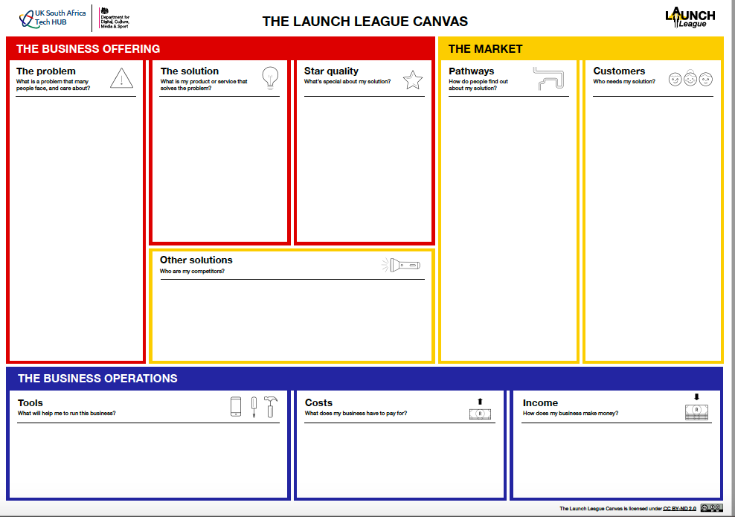
Many SA households and organisations use or rely on burning coal, wood, paraffin, or gas to cook.
These are unhealthy, unsustainable, and set to become less affordable.
The existing alternative are typically pricy, such as eco-friendly briquettes at high-end grocery stores.
Meanwhile, maize crops create a lot of unused waste which can be turned into briquettes.
Amaizing Briquettes sources maize waste from 15 local farmers, processes it into briquettes, and then sells it to retailers and a local school feeding scheme.
Amaizing Briquettes
Notes:
{Amaizing Briquettes Example}

Slide 25
Notes:
Once you are happy with your problem and solution statement, you can enter into your canvas.

Slide 26
1
i
Notes:
You have now completed Module 1! We will take a 15 minute tea break and then move onto Module 2.

Slide 27
MODULE 1:
Is there a need for my product or service?
Launch League Green

