Slide 1
TECH TOOLS 1: Marketing & Communications

Slide 2
What is Launch League?
This programme material was originally developed by the British High Commision UK-South Africa Tech Hub and Viridian through the Launch League initiative.
Launch League creates material and training/ networking opportunities for South African hubs and training organisations, so that we can better support YOU – promising entrepreneurs from our community!
www.launchleague.co.za

Slide 3
What tech tools do you already use to market your business and communicate with your customers?
Notes:
In this tech tools session, we will focus on a few free tools that can be incredibly useful to you as a small business, but particularly for your marketing and customer communications. You will be able to apply this to your meetup 1 homework exercise on customer validation.
{Question for group -- What apps, software, tools do you already use in your business?
1. For discussion with partner. 2. Group discussion and write on paper/ board as they name them.}
- 10 minutes
{Prompt for tools that are in every smartphone -- calculator, voice recorder for meetings, calendar, email, notes, camera for sending documents. And google tools - drive, calendar, gmail, forms}
Today, we’re going to explore 3 tools that you will be able to use for your customer validation.

Slide 4
Notes:
Whatsapp is an easy way for your customers to contact you and a great tool for you to use for marketing, sales and also customer feedback. Whatsapp launched its Whatsapp Business app in 2018, which is designed for small businesses.
{Question for class: Who already uses whatsapp for your business? How are you using it? Do you use your personal whatsapp or do you use whatsapp for business?} {Leave 5 minutes to hear how people are using it}

Slide 5
Free app designed for small businesses
Allows you to have a dedicated business whatsapp line for customers.
Run your personal whatsapp & business whatsapp from the same phone, different numbers
Notes:
{Explain how it works, having two numbers} -- you need a second sim card but not a second phone. When you download whatsapp for business, you will need to put the second sim in a phone so you can receive the pin code, but after this the sim card can be stored safely, and you will be able to run both whatsapp lines from your phone. You can also use a landline number to set up whatsapp business. You will get a verification call to the landline number.
If you choose to use one phone, however, you should be careful to tell customers that this number is only a whatsapp number.

Slide 6
Professional business profile
Address and map
Business description
Email address
Website
Opening hours
Logo or business photo as profile image
Notes:
With whatsapp for business, you can add these details to your profile and also use your logo as the profile picture.
{Screenshot on next page}

Slide 7
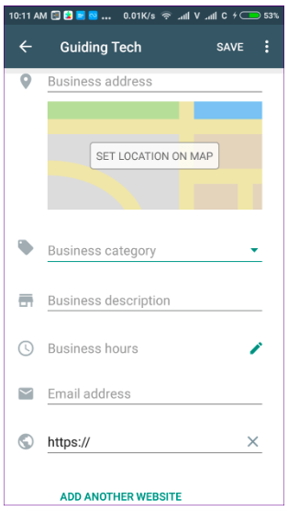
Notes:
Professional business profile

Slide 8
Greeting message
Lets you introduce your business to the customers using a greeting message.
The app automatically sends a greeting message created by you to every new customer or after 14 days of no activity with the said customer.
Notes:
You can add a greeting message that replies to incoming messages automatically.
You can also change who receives your message -- it could be everyone, or everyone who isn’t in your address book, or you can add some rules about who receives it.
{Screenshot on next page}

Slide 9
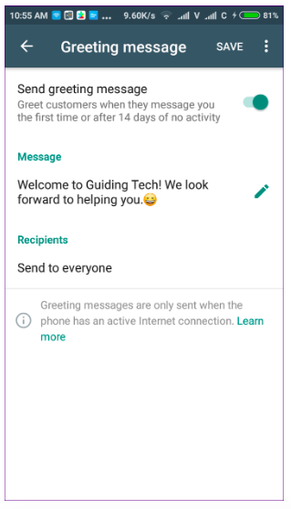
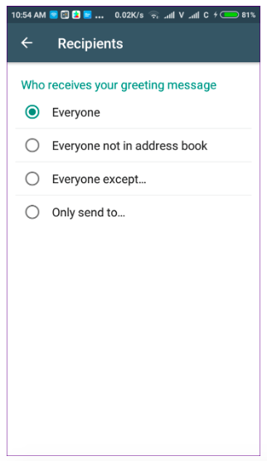
Notes:
Greeting message

Slide 10
Quick replies
Save standard reply messages to send to customers. Hello, thanks for choosing ABC Tutors! Please send your child’s school, grade, subjects and full name to get started.
Notes:
You can set quick replies - standardized answers to common questions or queries.
When a person asks a question, press the forward slash key (/), and you will see all the quick replies for you to pick one and save yourself from typing same responses repeatedly.
{Screenshot on next page}

Slide 11
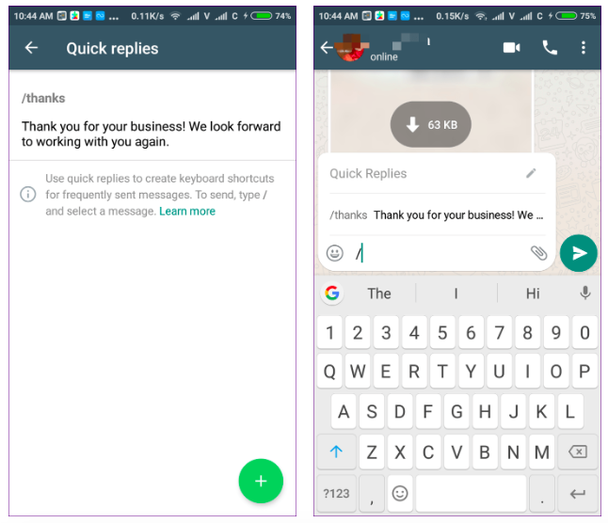
Notes:
Quick replies

Slide 12
Away message
Inform your customers that you are away.
You can customise the message or add a schedule for the away message.
Notes:
This is useful to set for weekends or after-hours when you don’t plan to reply to customers.
{Screenshot on next page}

Slide 13
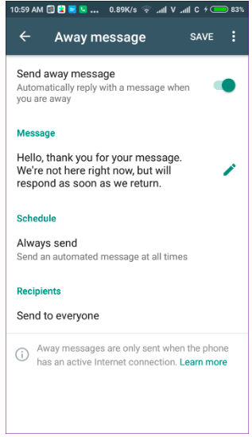
Notes:
Away message

Slide 14
Labels
Organise your contacts according to where they are in your sales funnel.
Allows you to create lists of customers for news and updates.
As soon as you have a new incoming whatsapp... 1. Save the contact with a standard format. e.g. first name/ first name & last name. 2. Add a label. Update these labels as conversations or they move through your sales funnel.
Notes:
This is where Whatsapp Business can act as your mini Customer Relationship Management Tool, organizing your contacts and at what stage in your sales funnel they are. It also allows you to create marketing lists.
{Screenshot on next page}

Slide 15
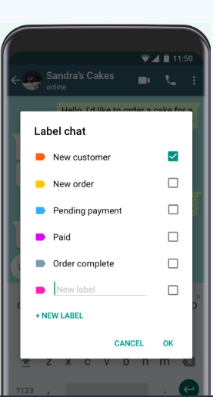
INTERESTED
PLACED ORDER
PENDING PAYMENT
TSHWANE CUSTOMER

Slide 16
Status
Use your whatsapp status as a valuable tool for marketing & also for customer validation.
How do your friends/ family use Whatsapp statuses? Have you seen any smart ways local businesses are using their Whatsapp status?
Notes:
{Question for group -- Who already uses their whatsapp status for their business?}
{Task for group -- everyone take out their phone and open whatsapp. When you go to statuses, can you see any other businesses using status? Turn to the person next to you and discuss how you think you could use statuses to promote your business or for customer validation.}

Slide 17
Short Links
Customers can click through and start chatting immediately
Use a short link on your social media posts, emails or on your website.
Add a whatsapp button to your FB page.
List your whatsapp number on all your marketing material. Use a short-link for online material.
Remember, customers need to message you first!
Notes:
You can add short links to your Facebook pages, posts, and ads.
To maximise the benefit of whatsapp for business, you want as many customers as possible to be reaching out to you via the line. So you should list it everywhere. And encourage customers to save you as a contact.
{Screenshots on next page}

Slide 18
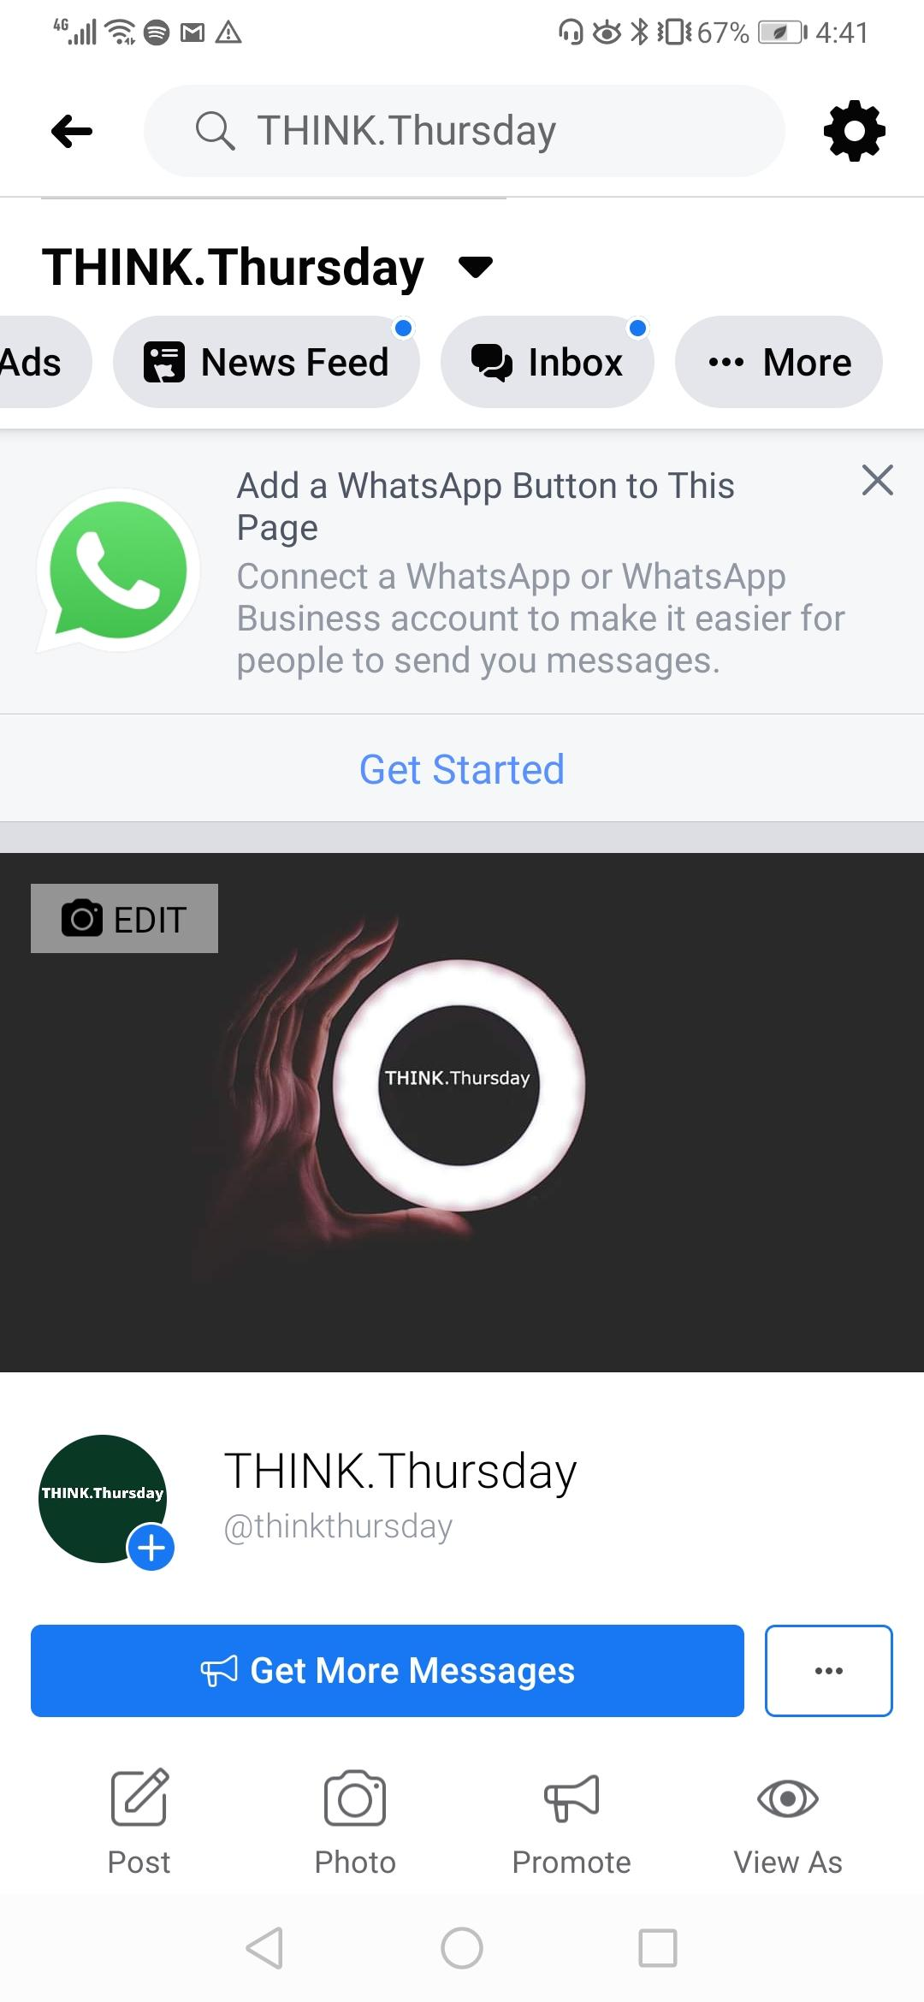
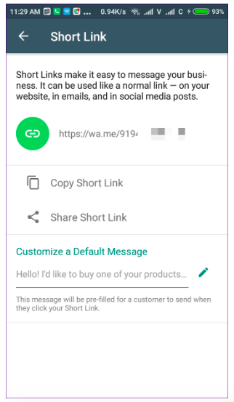
Notes:
Short links

Slide 19
Groups, broadcast
Whatsapp groups & broadcast work similarly to regular Whatsapp. GROUP - people can see other contacts (privacy?) and limited to 256 people. You can make a group with anyone (don’t have to have your number saved). vs BROADCAST - you can only broadcast to contacts that have your number saved.
Notes:
{Question for group -- when would you use a broadcast list and when would you use a group? What should you be aware of when using these tools?} {Allow 5 minutes for discussion: talking points on privacy, over-communication}
To use broadcast lists to, your customers need to have added you as contacts. You can use broadcast lists like an email newsletter and ask your customers to opt in for certain communication. You could add this to your welcome message.” E.g Thank you for your enquiry. Please add this number to your contact list if you’d like to receive news on new products and specials from ABC Tutors”.
Remember, you can create marketing or customer groups by adding labels -- e.g. Tshwane parents. Student tutors. News and Specials.

Slide 20
Whatsapp for web
Open Whatsapp on your computer browser for better efficiency.
web.whatsapp.com
Notes:
{Question for group -- who uses whatsapp for web?}
Very useful for people who do a lot of their work from their computer. Your phone needs to be on at the time.

Slide 21
Whatsapp business – Your most valuable channel to customers?
In order to really leverage whatsapp as a marketing and customer relationship management tool, customers must message you first.
Ask customers to save your whatsapp number & “opt-in” so you can send them marketing messages.
They add you + you add them!
Add contacts in standardized format.
Notes:
When you receive a message, save the contact in your whatsapp in a standard format. It might be customer 52 and you may choose to add their first name too, or area as a contact.

Slide 22
Is Whatsapp for business a good fit for your business?
Notes:
{Question for class - who thinks that whatsapp business is a good fit for their business? How do you think you will use it? {Partner discussion on how you think you can better leverage whatsapp as a tool in your business} - 5 minutes

Slide 23
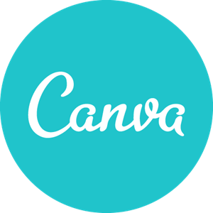
Notes:
{Question for group -- Anyone used canva before? How did you use it? How do you currently get marketing material created?}

Slide 24
Free, easy to use
Canva allows you to make marketing material for your business, for print or online use for free.
“Canva PRO” is a paid subscription but you do not need this to use Canva.
Mobile app or desktop
Upload your logo or create a logo
Notes:
The mobile app works for basic designs but it is a lot easier to use on desktop.

Slide 25
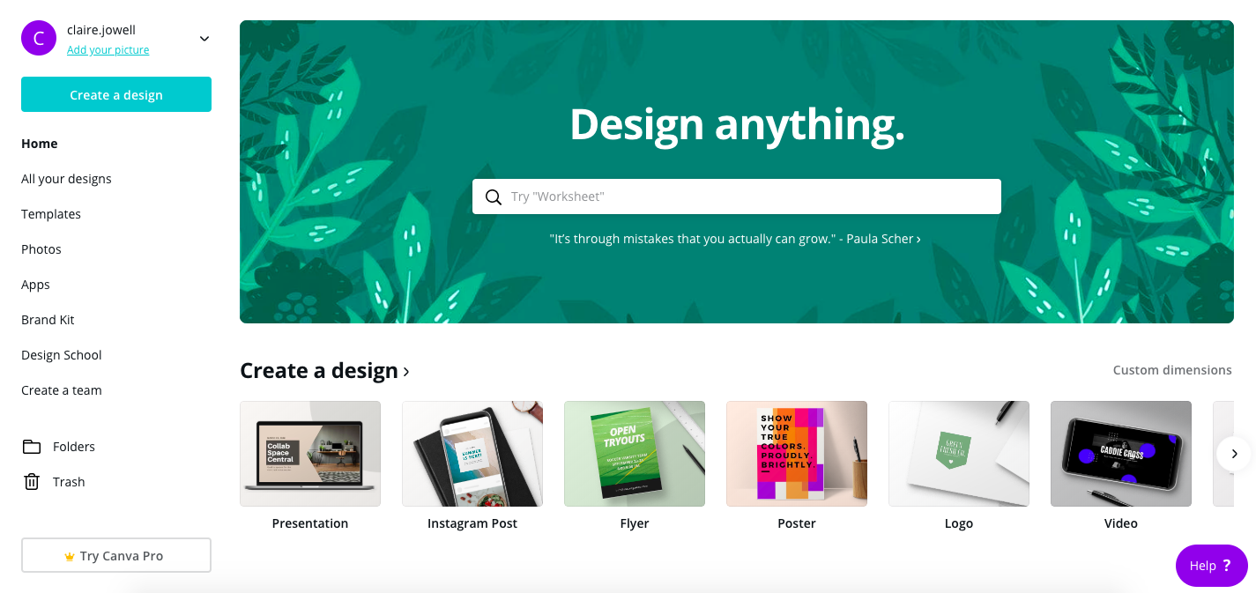
Notes:
Canva has hundreds of templates for you to use -- from social media posts, flyers and posters to certificates.
Or you can create your own from scratch.
All your designs are saved on your canva profile so you can go back and edit whenever you want. You can download as an image or as a pdf, and then attach to an email to send for printing.

Slide 26
Design tips for using Canva
Upload your logo and use it consistently across all of your material.
If you don’t have a logo, you can make one on Canva.
Select your brand colours (2 or 3) and use these consistently across your material so it always looks similar.
Always use a similar design so customers start to recognize your material.
Notes:
It is important for your marketing material to look consistent so that customers recognize it. It is a good idea to spend some time creating templates for each marketing piece you will need. Social media post, posters, flyers.

Slide 27
Notes:
{Question for group: who is using Facebook to promote your business? How are you using it?}
Today, we will just look at one aspect of Facebook as a tool that you can leverage for customer validation that you will be doing for your first meet-up.

Slide 28
Facebook polls
Ask your friends what they think of your idea
Ask your customers what they want from your product or service
Add a poll from your business page, in a group, or add to your personal Facebook story.
Personal profile -- add to story
Business profile -- add as a post
Notes:
{Question for group - Who has created a poll on Facebook before?}
People love polls! Polls are great ways to get quick feedback from your potential customers, and your customers.

Slide 29
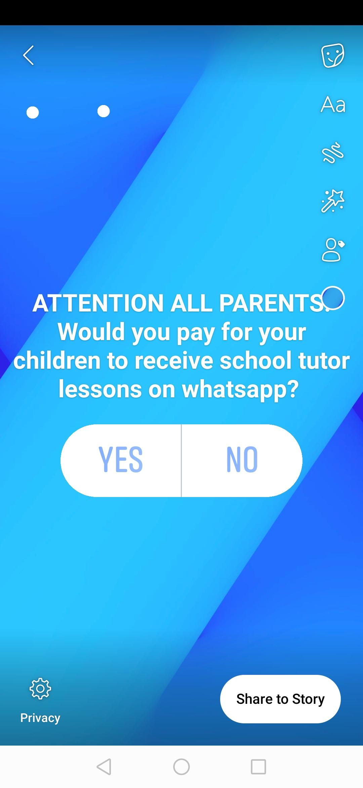
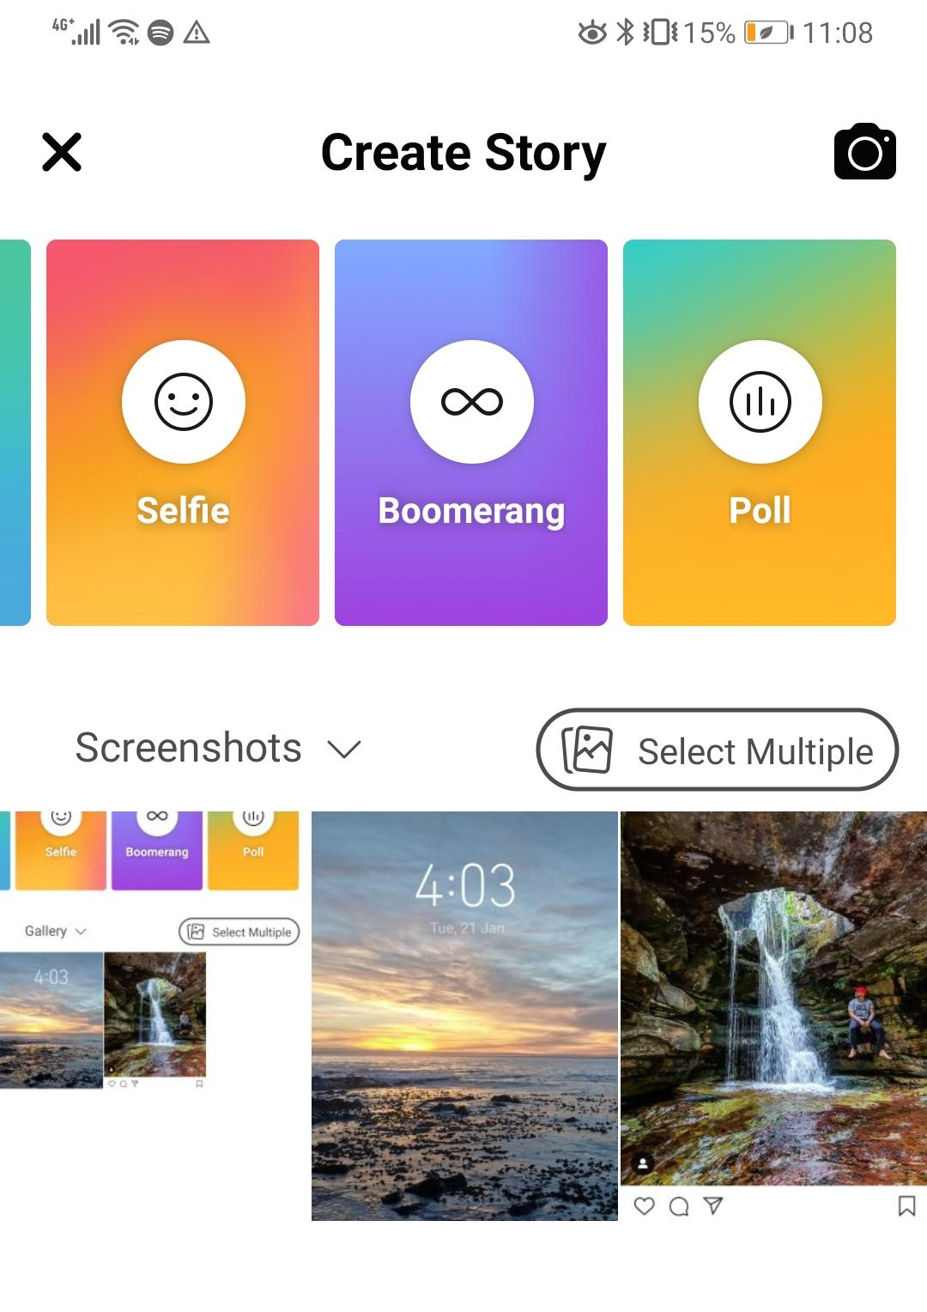
Notes:
From your personal profile you can no longer add a poll as a status on facebook. You have to create a poll in your personal story, in a group or on a page.

Slide 30
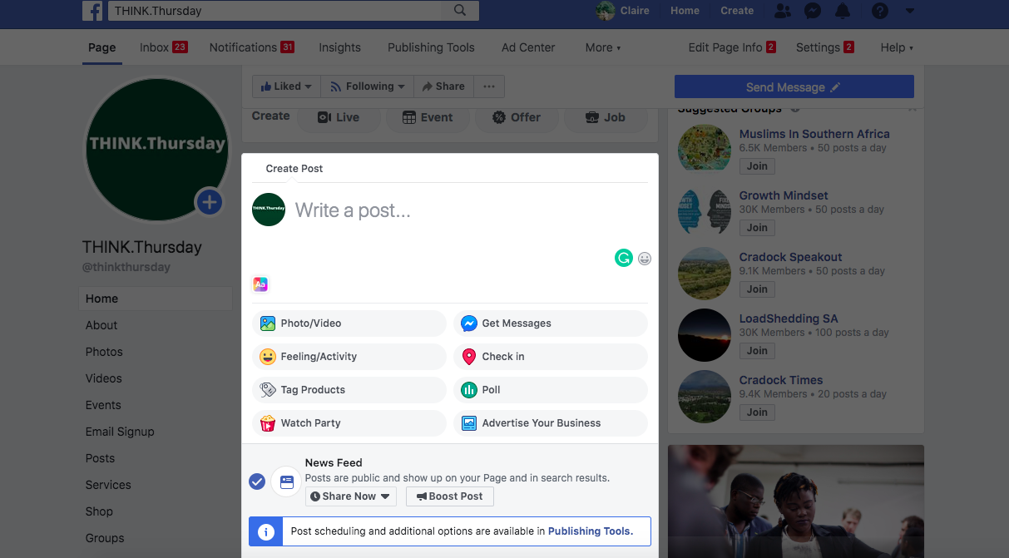
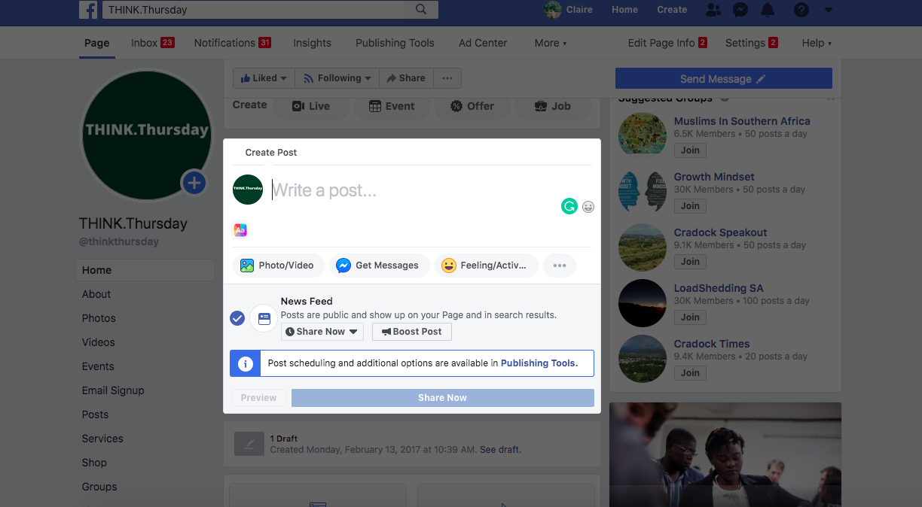
Notes:
From your business page, you can create a post, then select poll.

Slide 31
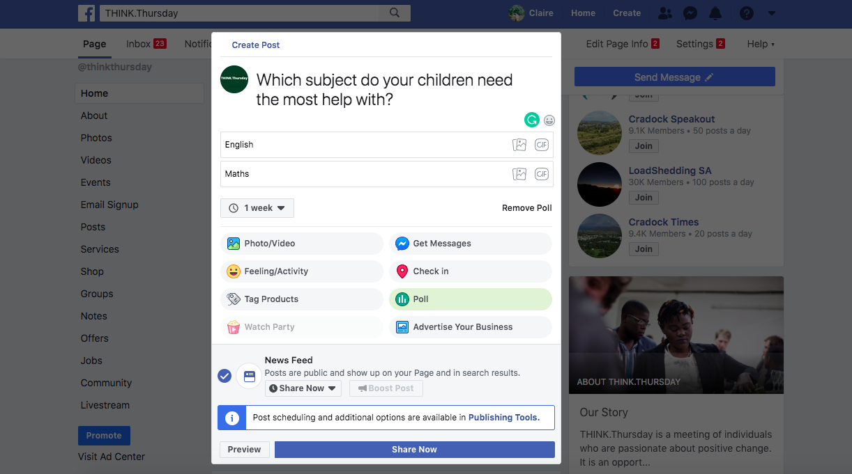
Copyright UK-SA Tech Hub 2020
Notes:
You can add your question, 2 answers and how long the poll is open for.

Slide 32
Your turn

Slide 33
Explore Canva & create an image
Download the Canva app
Register
Have a look around
Create an image for a Whatsapp story that tells potential customers about your solution. Refer to your solution statement!

Slide 34
2. Create a poll
You’ll be doing some customer validation for your first meetup. A poll is a great way to get quick answers from your network and customers
Think of one question you’d like to ask and set up a poll on Whatsapp, Facebook or another channel.

Slide 35
TT
2
1
i
Notes:
Congratulations on making it this far! One more module and one more tech tools session, and you’ll finally be a Launch Leaguer!

Slide 36
TECH TOOLS 1: Marketing + Communications

